Slide 1
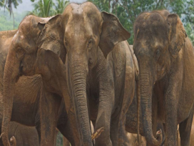
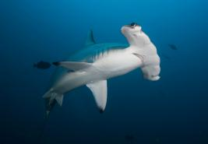
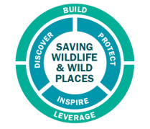
WCS and International Conservation Policy
Dr. Susan Lieberman
Wildlife Conservation Society
20 March 2014

Slide 2
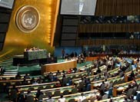
International Policy and WCS
What is international policy? What is policy?
National & International Policy
Why engage with intergovernmental organizations, treaties, the UN, etc.?
How does work on policy deliver conservation outcomes?
Some examples (from wildlife trade)
₂

Slide 3
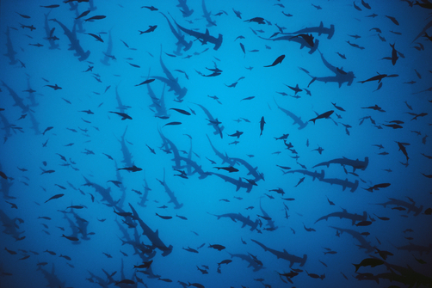
International Policy
Efforts to influence government decision-making in intergovernmental fora
Can be an effective tool to advance science-based decision-making
Advocacy with government decision-makers engaged with intergovernmental fora
Relationships in multilateral fora with governments, industry, NGOs, media
Can create the enabling environment to deliver on conservation strategies, goals and objectives—at the international and national levels
₃

Slide 4
Some case studies—policy examples involving international wildlife trade
Sturgeon
Queen conch
Seahorses
Marine turtles
Whales/whaling
Mahogany
Sharks
₄

Slide 5
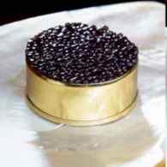
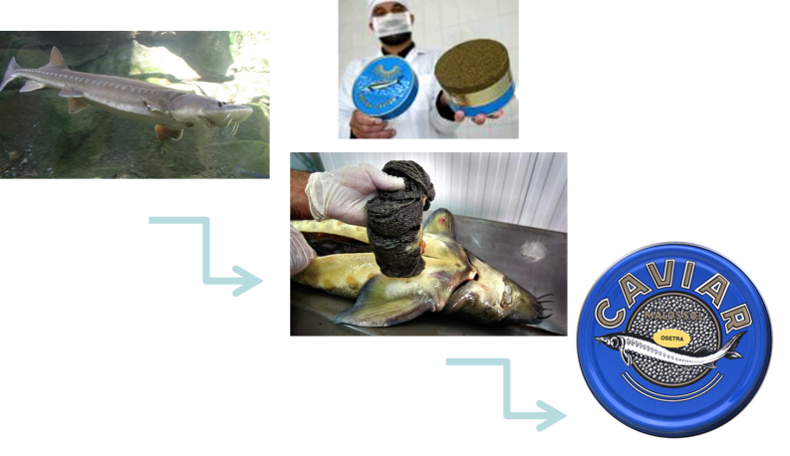
Sturgeon and caviar
“Stricter controls on importing and exporting as per CITES policies may be having a positive conservation effect by limiting the amount of fraudulent caviar reaching the marketplace….
Other marine and aquatic species stand to benefit from the international trade regulation that can result from CITES listing.”
₅

Slide 6
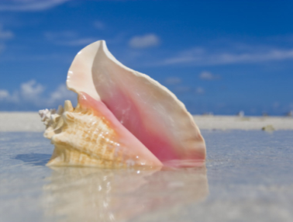
Queen Conch
Large commercial fishery for meat and shells
Significant source of economic revenue for the Caribbean region
Annual landings estimated to be $US 60 million
Listed on CITES Appendix II 1992
₆
Notes:
-

Slide 7
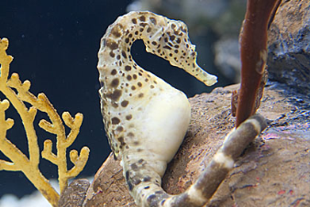
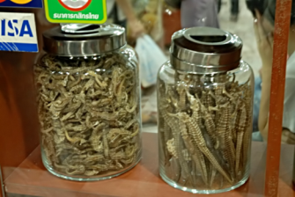
Seahorses
Traded internationally: aquariums, souvenirs, traditional Asian medicine
~24 million seahorses taken from wild and sold for use in traditional Chinese medicine
CITES Appendix II 2002
₇

Slide 8
Marine turtles: Hawksbills (Eretmochelys imbricata)
Significant illegal trade
Bekko market and carving industry in Japan
Major controversy in 1990s
Reservations and CITES
Cuba downlisting controversy

Slide 9
Whales and whaling

Slide 10
Swietenia macrophylla (Bigleaf Mahogany)
Its natural range extends across tropical Central & South America.
It has long been sought after because of its color and durability
This demand drove logging to unsustainable levels in the 1990s; much was illegal.
The species became commercially extinct across much of its range.
Prices rose sharply as volumes in trade fell.
National-level action was insufficient

Slide 11
Appendix II listing was first proposed at CITES CoP8 in 1992 (Costa Rica, USA)
It was heavily opposed by trade interests in many range and importing States
It was defeated then and at two later CoPs
CoP9 (1994): Netherlands
CoP10 (1997): Bolivia, USA
CoP11 (2000): no proposal
CoP12 (2002): Guatemala, Nicaragua

Slide 12
2002 (CoP12): adopted an Appendix II proposal from Nicaragua & Guatemala, to enter into effect after one year.
Brazil opposed but later established an export moratorium until a management plan was drawn up for the species.
The plan is in place and exports have resumed but in relatively smaller quantities.

Slide 13
Peru filled the vacuum with exports of 54,000 m³ in 2002.
They did not have the necessary information on which to base a non-detriment finding
They exported stockpiles felled before 2002 without any attempt at a non-detriment finding – a practice not allowed by CITES
Harvesting continued illegally in protected areas and isolated indigenous tribes were under threat.

Slide 14
In 2007, Peru faced sanctions from CITES unless it improved its management and reduced its quota.
It agreed to:
an export quota of 5,000m³ based on approved and verified concessions; and
ratification at the highest level of a comprehensive plan of action for Mahogany.
CITES agreed to a plan of action for the species for all range States.

Slide 15
Lessons learned?
The commercial value and sheer bulk of trade in quality timbers, together with corruption and poor governance in many range States, makes sustainable management regimes difficult.
BUT—CITES can be a powerful tool for commercially valuable timber species, and can help drive action at the national level
Good forestry practice can deliver a robust non-detriment finding under CITES.
CITES and ITTO are working together on capacity building to assist in making NDFs for listed species.

Slide 16
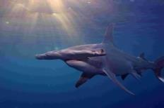
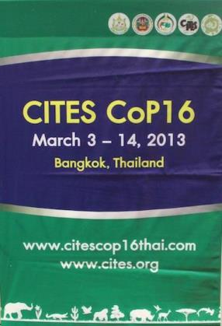
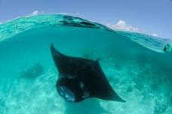
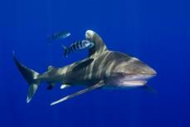
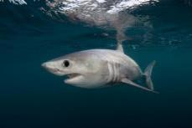

Slide 17
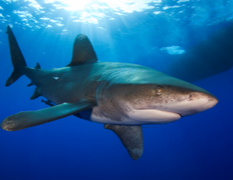
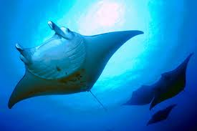
CoP16 Shark and Manta Ray Proposals
Significant declines driven by international trade
Highly vulnerable species
All need management, regulation, CITES Appendix II Listing
Hammerheads
Oceanic Whitetip
Manta Rays
Porbeagle
₁₇

Slide 18
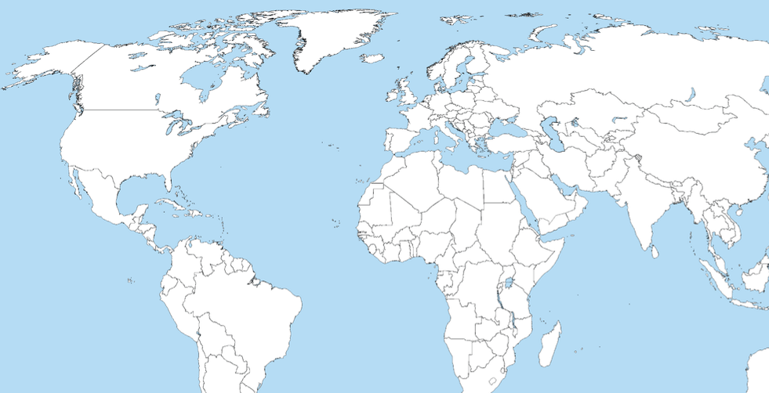
Shark and rays, CoP16
Proponent countries
Porbeagle shark | Lamna nasus | Brazil, Comoros, Croatia, Denmark (on behalf of the 27 EU Member States), Egypt
Oceanic whitetip shark | Carcharhinus longimanus | Brazil, Colombia, USA
Scalloped hammerhead Great hammerhead Smooth hammerhead | Sphyrna lewini S. mokarran S. zygaena | Brazil, Colombia, Costa Rica, Denmark (on behalf of the 27 EU Member States), Ecuador, Honduras, Mexico
Manta rays | Manta spp. | Brazil, Colombia, Ecuador
Proposals submitted by 37countries

Slide 19
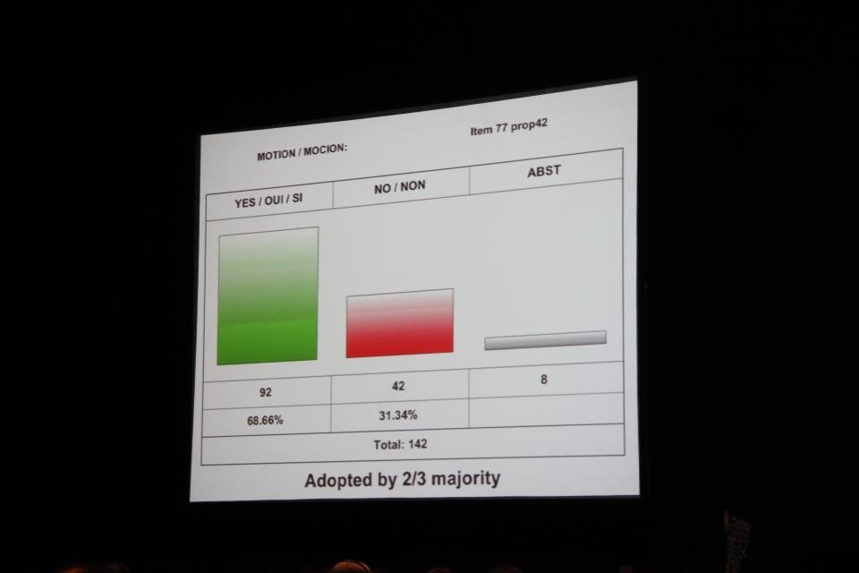
Shark votes in Committee
 | For | Against | Abstain | % in Support
Oceanic whitetip shark | 92 | 42 | 8 | 68.6%
Hammerhead sharks | 91 | 39 | 8 | 70.0%
Porbeagle shark | 93 | 39 | 8 | 70.4%
Manta rays | 96 | 23 | 7 | 80.7%

Slide 20
Next steps: CITES implementation
18-month delay for listings to take effect – Sept. 2014
Capacity-building for implementation
Legal frameworks
Administrative infrastructure
Technical capacities – identification, NDFs, trade monitoring, enforcement
Leveraging funding and in-kind investments: €1.2 million from European Commission, other governments
Workshops, priority-setting, outreach – CITES Secretariat, FAO, governments, several NGOs

Slide 21
Sharks & Rays—Multilateral Instruments
Regional fisheries management organizations and agreements (RFMOs) and Regional Fisheries Commissions
UNGA,
UN organizations (ex: Food & Agriculture Org., Fisheries)
Multilateral agreements:
CBD, CITES, CMS, UN Regional Seas Agreements

Slide 22
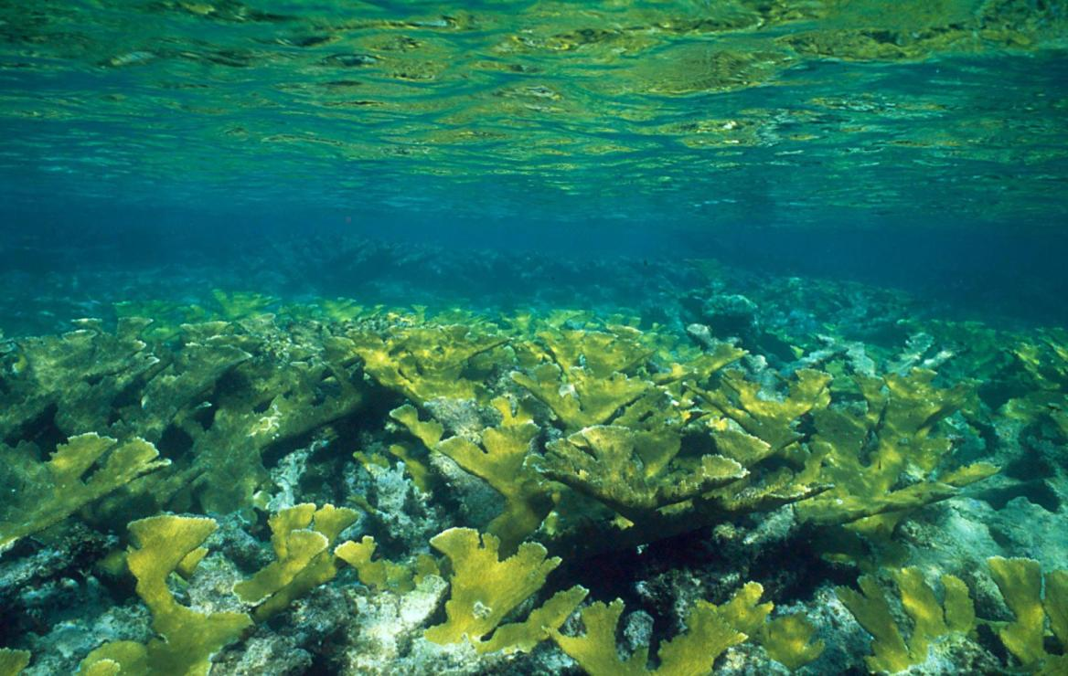
Priority International policy areas WCS 2020: Leverage
Wildlife trade in high value products—particularly illegal trade
Protected areas—including protected area establishment and effective management, corridors and landscape/seascape connectivity, & forest conversion and fragmentation
Freshwater and coastal artisanal fisheries.
₂₂

Slide 23
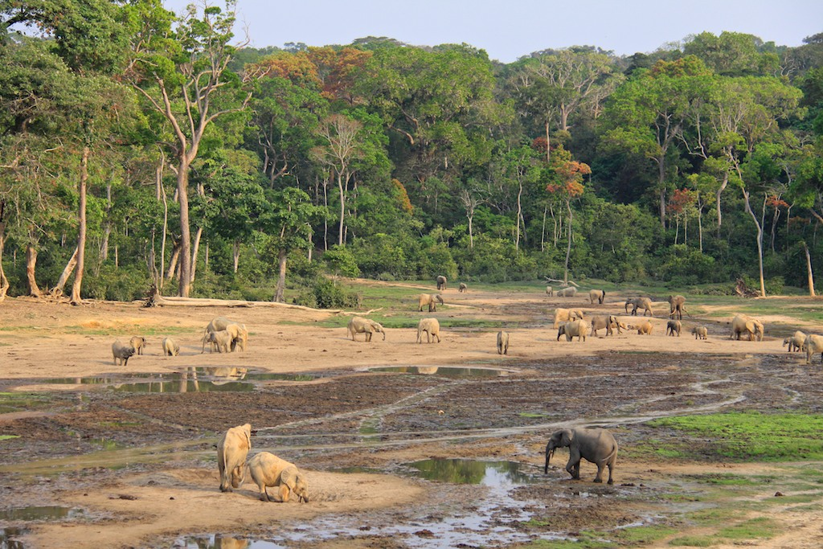
Area-based: Protected areas, corridors, and connectivity
Protected areas: establishment and effective management
Corridors and landscape/seascape connectivity
Forest Conversion and Fragmentation
₂₃

Slide 24
Intergovernmental Policy Priorities (2014)
High priority: Fora that will be the highest priority for Global Policy, and for WCS organizationally
CITES
World Parks Congress
World Heritage Convention
₂₄

Slide 25
Intergovernmental Policy Priorities (2014)
Medium priority: Fora that are important, and will also involve time and effort.
UNGA, UNODC
FAO
CBD
UNFCCC
IPBES
WHO, OIE
IUCN
₂₅

Slide 26
Thank You

