Slide 1
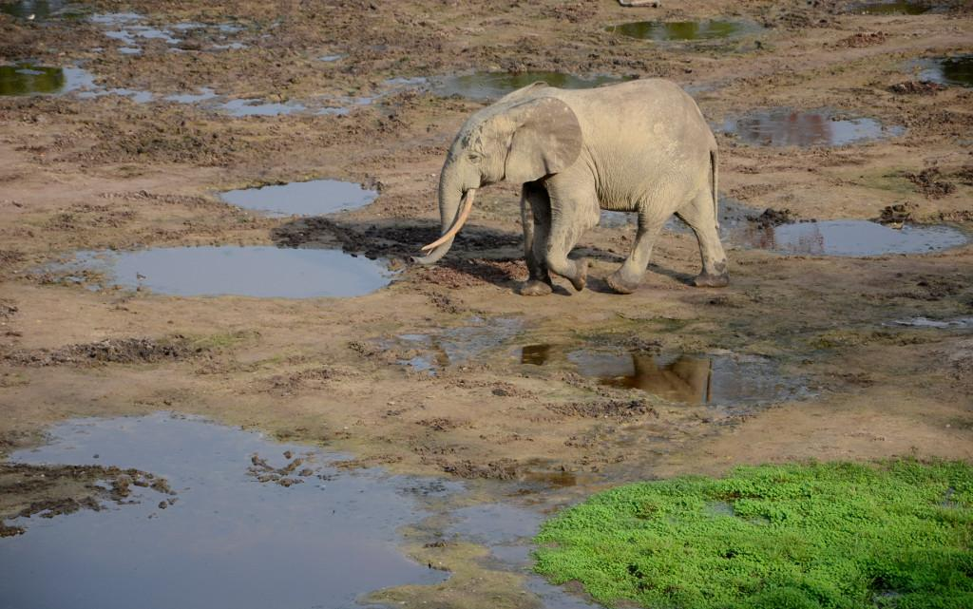
Wildlife Trade Program
2014

Slide 2
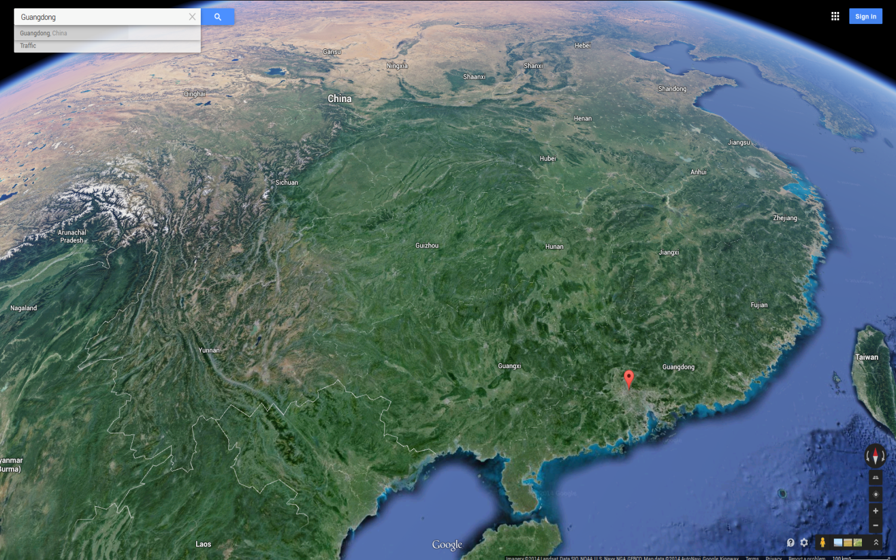
At the crossroad of international trade routes and at the center of a major consumption area, Guangzhou is the main battleground for wildlife conservation in China.
Guangzhou

Slide 5
?

Slide 6
Stop the illegal trade of key wildlife species in Guangdong Province
Target Wildlife Species: Animals listed on CITES App. I, App. II (Zero Quota), and National Class-1 Protected Species of China.

Slide 7
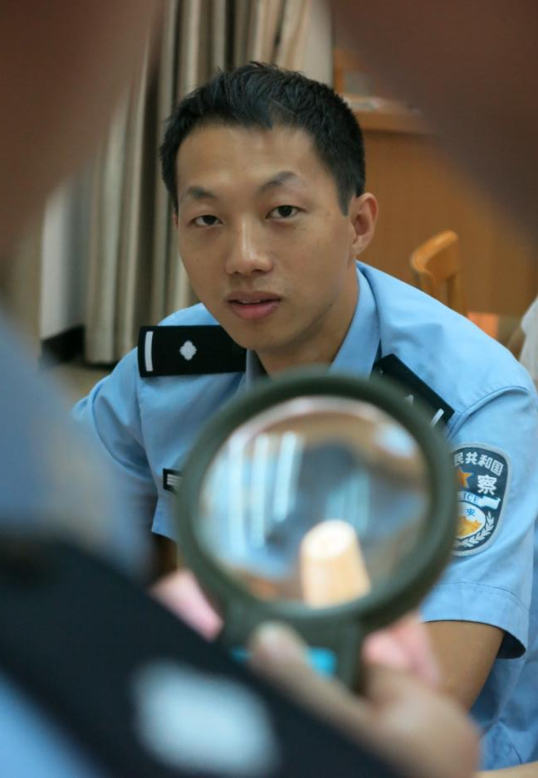
Capacity Building
19 training workshops delivered 2010-2013
992 front line law enforcement officers empowered
10 gov. agencies benefited in GuangDong, GuangXi, QingHai. (incl. Customs, Forestry Police, Fishery bureaus, Wildlife Protection Office, Industry and Commerce Bureau)
Training contents:
sensitization about wildlife conservation,
hands on practice to identify species and products,
legal framework for wildlife protection,
management of confiscated animals,
animal rescue techniques, etc.
empower and support law enforcement agencies

Slide 8
Lessons learned
90% trainees consider on-site species identification problematic (accuracy and efficiency)
Low knowledge retention after a period of time
Avg. knowledge increase after training >200%
Avg. knowledge retention after 6 months 36.7%
Response:
Develop tools for on the spot scientific reference and easy expert consultation (Wildlife Guardian app)
Maximize hands-on practice (comparison btw real and fake products, guided visits to zoos and museums)
More compact trainings (1-3 days)
Higher frequency trainings (5-6 workshops/year)
Expand coverage of trainees/agencies
Trainees knowledge retention
empower and support law enforcement agencies

Slide 9
Wildlife Guardian
1.22 billion phones in China, 73.2% smartphones
(2013)
An opportunity
to provide on-the-spot support
to maintain knowledge over time
to increase portability of reference materials
to expand educational outreach
to facilitate public engagement
empower and support law enforcement agencies

Slide 10
Wildlife Guardian
Intuitive graphical identification of 482 traded species (mammals, birds, turtles, tortoises)
Guided identification of 18 wildlife products (ivory, horns, skins)
Online expert support around the clock
Reference database of 100+ laws, regulations, and guidelines about wildlife conservation
Smart and easy report function for the public
Release date of Wildlife Guardian version 2
All the reference, handheld.
empower and support law enforcement agencies

Slide 11
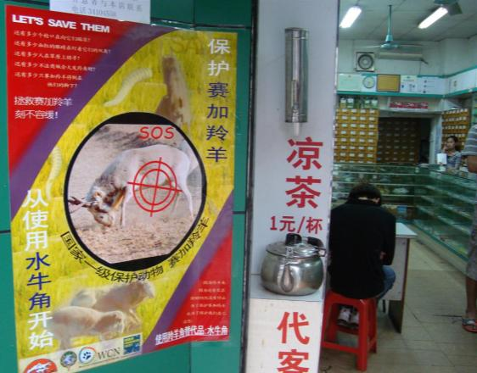
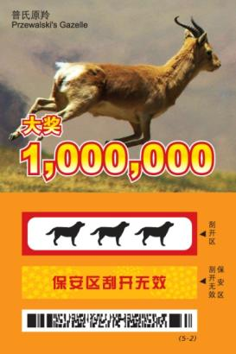
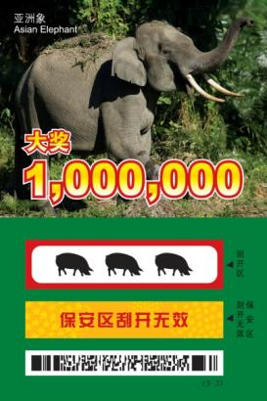
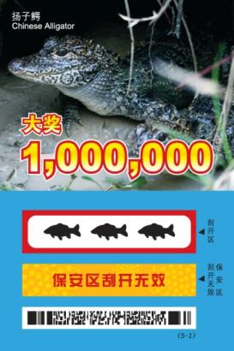
Outreach activities for demand reduction
Posters at the entrance of TCM stores
Scratch card lottery
outreach and demand reduction

Slide 12
Lessons learned
Limited Impact without strategic and systematic planning
Social media team set up and the demand reduction project kick off from 2013, focusing on ivory
Market surveillance

Slide 13
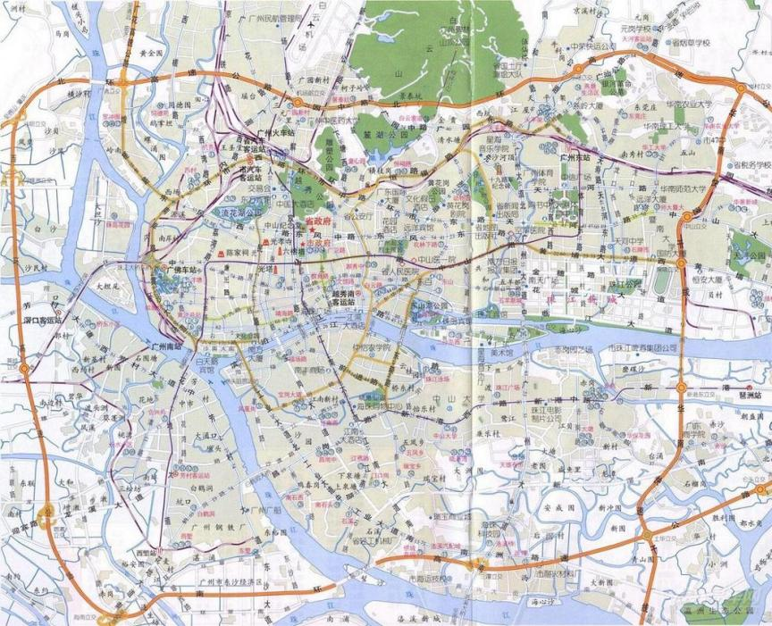
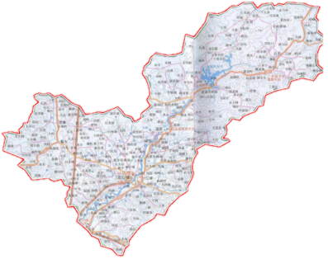
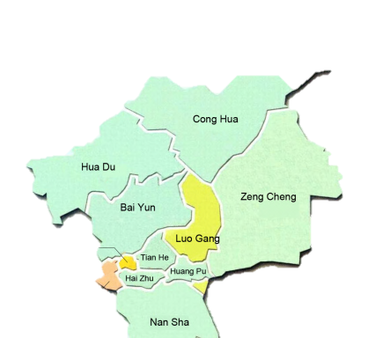
Market monitoring and surveillance
5 market categories
Chatou
(Food)
Liu Hua (Closed)
(Pet)
Huangsha
(Wet food)
Hualin
(Ivory)
Xingfu in Conghua
(Food)
Qingping
(TCM)
Huadiwan
(Pet)
Tianjia
(Wet food)

Slide 14
Understanding illegal market trade
Survey methodology (Jul 2011 – Jun 2013)
pet markets: monthly
1st / 2nd half of the month
weekdays/weekends
morning/afternoon
Food/wet food markets: monthly
1st / 2nd half of the month
weekdays/weekends
2 hours slots rotating over 24 hours
TCM market: Twice a year
Occupancy
Handicraft Market: To be decided
Online markets: monthly
(Updated by Emma J. Stokes)
Processing of 2009-2013 data of bird, turtle and saiga antelope (for TCM) trade is currently ongoing
External consultants have been recruited to help with data processing, and to advise on the survey methodology adopted
Market surveillance

Slide 15
Intelligence & investigation
Open market surveillance with periodic reports on our findings sent to:
CITES MA Beijing
State Forestry Police Department
CITES MA Guangzhou
Guangdong Forestry Police Department
Guangzhou Forestry Police Department
Guangdong Wildlife conservation and management Office
Guangzhou Wildlife conservation and management Office
Law enforcement operations initiated by periodic report: Zero case
Law enforcement operations initiated by individual intelligence: Seven cases
Time | Information from | Market | Species
2010 | Lai | Huadiwan pet | Turtles and tortoises, Lizards
2010 | Mingxia | Conghua food | Turtles and tortoises
2010 | Mingxia (GZ FPD) | Qingping TCM | Mongoli horn
2011 | Informant A | Online | Loris
2012 | Informant B | Conghua food | Birds of prey
2013 | Fuping | Huadiwan pet | Turtles and tortoises
2014 | Joe | Hualin Jade | Ivory
Market surveillance

Slide 16
Lessons learned
Periodic reports did not result in any enforcement action
Work with law enforcement agencies with real-time reports
Law enforcement agencies showed little interest in small reported cases
Collaborate with local NGOs to concentrate pressure on specific markets;
Explore feasibility of undercover investigation in cooperation with law enforcement
Staff and collaborators risk exposure during covert investigations
Adopt a robust risk assessment and mitigation procedure
Market surveillance

Slide 17
What the LE focus?
Priority 1: Big cases (Performance oriented)
What the LE need?
- Deep and accurate intelligence of big deals, supported by a strong and professional informant network.
Gaps:
- Weak professional informant network
- Limited resource to develop the informant network
- Restriction on some process during LE
Priority 2: Open markets (Routine jobs)
What the LE need?
- Real-time and accurate intelligence, but no so frequent
Gaps:
- Strong incentive to do LE in open markets
- Shortage of manpower
- Shortage of species ID skills
Priority 3: Scattered cases reported by public
Market surveillance

Slide 18
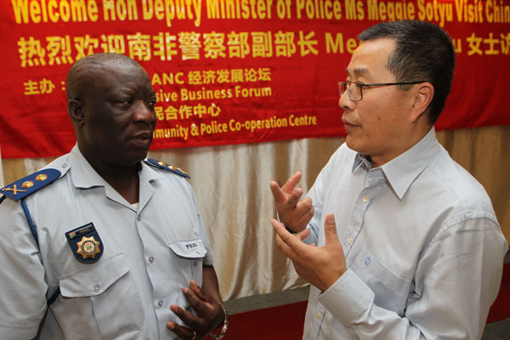
International Cooperation
Cobra II Operation (Dec 2013-Jan 2014)
Supported by WCS: Two officers from China Customs and CITES MA were seconded to Lusaka Agreement Task Force (LATF) in Kenya to support coordination and execution of the operations.
28 countries involved
>150 arrests and > 150 major wildlife seizures, > 50% handled by China.
33 rhino horns, >2 metric tons of elephant ivory, >10,000 turtles, > 1,000 skins of protected species, > 10,000 European Eels and > 200 metric tons of rosewood logs.
The first joint China-Africa undercover sting operation
empower and support law enforcement agencies

Slide 19
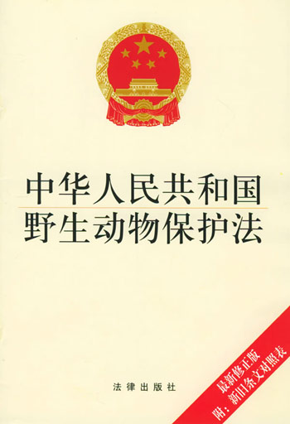
Legal Review
Central government started to focus more on environmental protection and sustainable development
- The Eighteenth Congress: Ecological civilization, Beautiful China
- New laws under hot negotiation
With more and more open channels, China is under pressure from international, media and public
- The central media CCTV reported the wildlife trade and corruption situation of local government
- 6.1 tones of confiscated ivory destroyed in Jan 2014/ Cobra I/II operation
- Guangzhou FPD doubles the law enforcement in the open markets
Time to review after the legal review in 2009
LAW OF THE PEOPLE'S REPUBLIC OF CHINA ON THE PROTECTION OF WILDLIFE
Market surveillance

Slide 20
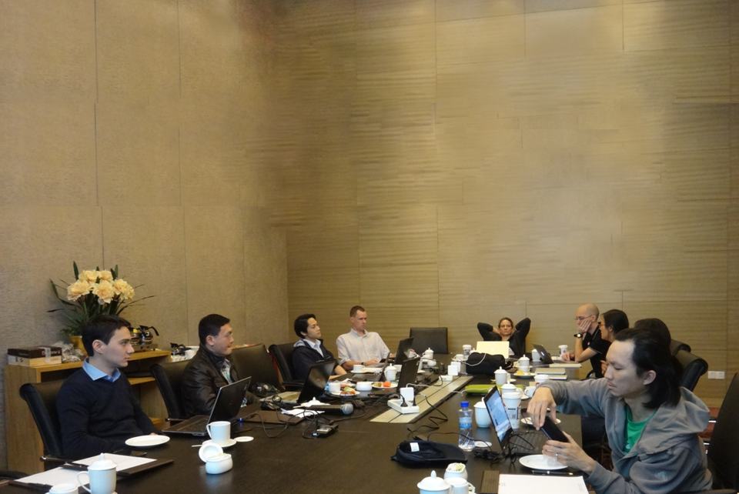
Strategy review
Trade team project strategy review – February 25-28, 2014

Slide 21
By 2020, stop the illegal trade of target wildlife species in China
Stop open sales of key species illegal wildlife in Guangzhou markets
Disrupt and dismantle criminal networks throughout the supply chain (GD, GX)
Strengthen policies, legislation and regulations to ensure effective deterrence against wildlife trafficking
Remove the threat of ivory trade to the survival of elephant through demand reduction
Activity 1
Provide intelligence to law enforcement agencies for enforcement actions through regular cooperation
Activity 1
Gather accurate information and intelligence on the criminal networks trading in wildlife
Activity 1
Collect an updated comprehensive database of law, regulations, judiciary decisions and interpretations
Activity 1
Stimulate the online engagement of netizens
Activity2
Enhance technical capacity of law enforcement agencies (FPD, Fisheries, Industry & Commerce Bureau) through Wildlife Guardian app, and capacity building trainings
Activity 2
Facilitate an effective response by the appropriate law enforcement authorities to actionable intelligence
Activity 2
Engage the corporate sector (CSR)
Activity 2
Provide technical inputs into the wildlife law reform process
Activity 3
Behavioral change campaign to “vilify” ivory
Activity 3
Enhance technical capacity of law enforcement agencies (FPD, Customs, Traffic, Border Police) (APP + Capacity Development)
Activity 3
Work with partners to develop proposals for the People’s Congress, CPCC, and provincial level legislative bodies
Activity 3
Build a network of active media to showcase successful enforcement cases, while also exposing the failures
Activity 4
CSO/NGO/Media outreach creating one platform with coordinated initiatives
Activity 4
Facilitate international cooperation and coordination between relevant authorities
Activity 4
Investigate working more closely with China CITES authorities (TBC)
Indicator
Presence of target species attained through systematic monitoring of the target markets
Indicator
See ad hoc PPT for details
Indicator
Arrests, prosecutions and affective punishment of key individuals
Indicator
Specific articles in laws, and policy directives

Slide 22
Previous:
Stop the illegal trade of key wildlife species in Guangdong Province
New:
Stop open sales of key species illegal wildlife in Guangzhou markets
Disrupt and dismantle criminal networks throughout the supply chain in Guangdong and Guangxi.
Target Wildlife Species: Animals listed on CITES App. I, App. II (Zero Quota), and National Class-1 Protected Species of China.

Slide 23
Goal
Stop open sales of key species illegal wildlife in Guangzhou markets
Disrupt and dismantle criminal networks throughout the supply chain in GD and GX.
Location
Poaching Site
Landscape
Transport nodes
Underground Trade in key cities
Open Markets in key cities
End Consumption Site
Criminal Network
Public
Transaction Chain
Poachers
1st level dealers
Logistic Companies
2nd level dealers
3rd level dealers
Consumers
Key forces
Local LE
Customs /Border Police /Traffic Police
FPD / Fishery Bureau
Government/ Media/Civil society
Activities
International cooperation: China-Africa, Vietnam-GX, Lao-Vietnam-GX-GD
Build up informant network and collect deep intelligence to support LE, esp. for big cases underground.
Data collection and analysis 2009-2013
Demand reduction project
Work with other NGO in Market surveillance
Encourage public report – the App
Gap 1: Comprehensive understanding of the underground market and transition chain
Gap 2: Intelligence to support LE
Gap 3: Informant network buildup and manage skills
Gap 4: Risk assessment and mitigation
Notes:
23

Slide 24
Build up informant network and collect deep intelligence to support LE, esp. for big cases underground.
Gap 1: Comprehensive understanding of the underground market and transition chain
Gap 2: Intelligence to support LE
Gap 3: Informant network buildup and manage skills
Gap 4: Risk assessment and mitigation
Activities
Questions to be answered:
1. How to setup a professional informant network?
How many we needed? 1 or 2 in each market?
What basic skill they need?
What’s the relationship between the informants and WCS? Fulltime/Part time staff? Simple partner?
- How’s the salary package? By cases?
Through what channel to recruit them? etc.
2. How to manage and operate the informant network?
By monthly report? How to make sure their loyalty (as some of them are probably previous traders)?
Are they constrain by WCS regulations? Such as purchasing some illegal products.
Can they directly contact the LE agencies? Or through WCS staff?
3. What information we need and how to collect?
- Is there a list of these information?
4. How to keep WCS staff and the informants safe?
- How deep level we go? What can be done and what can not?
Is the current risk assessment practical?
Standard protocol when emergency situation happened? Such as kidnapping
5. Possibility of assigning a specific consultant to support China program to setup and manage the informant network?
Notes:
24

