Slide 1
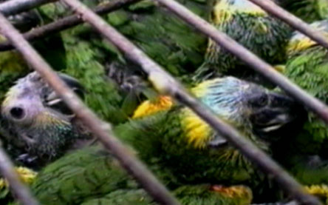
Wildlife Trafficking
Latin America and Caribbean Program
Regional Meeting
April 2015

Slide 2
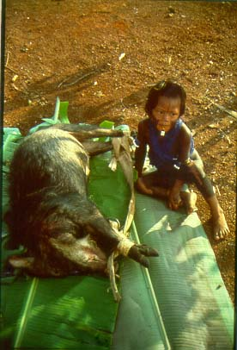
Hunting is almost ubiqutous across Latin America. Its intensity, and hence sustainability, is a spectrum.
Local hunting for food. Many species. For some species in some areas, sustainable (low human population densities). Might or might not be legal.

Slide 3
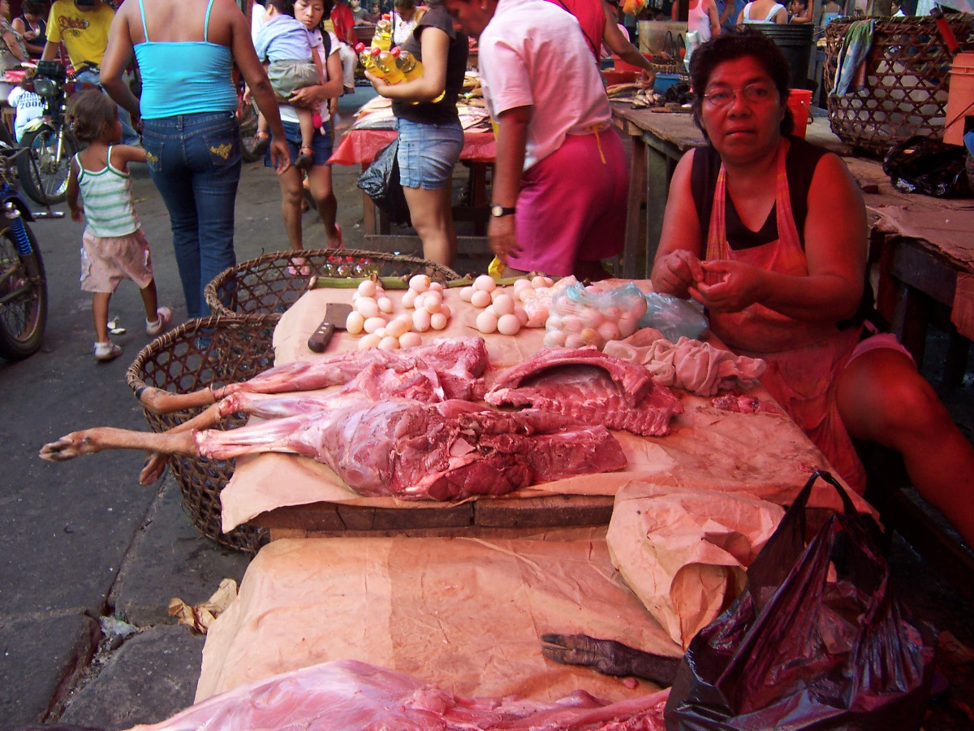
Hunting for (local) sale. Many species. Might or might not be sustainable, but in many cases will not be. Might or might not be legal.

Slide 4
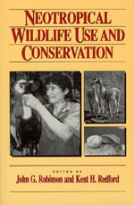
How do we know what is sustainable? WCS led the thinking.
Robinson and Redford (1991) model for maximum productivity for species. They used that to calculate maximum sustainable potential harvest rates.

Slide 5
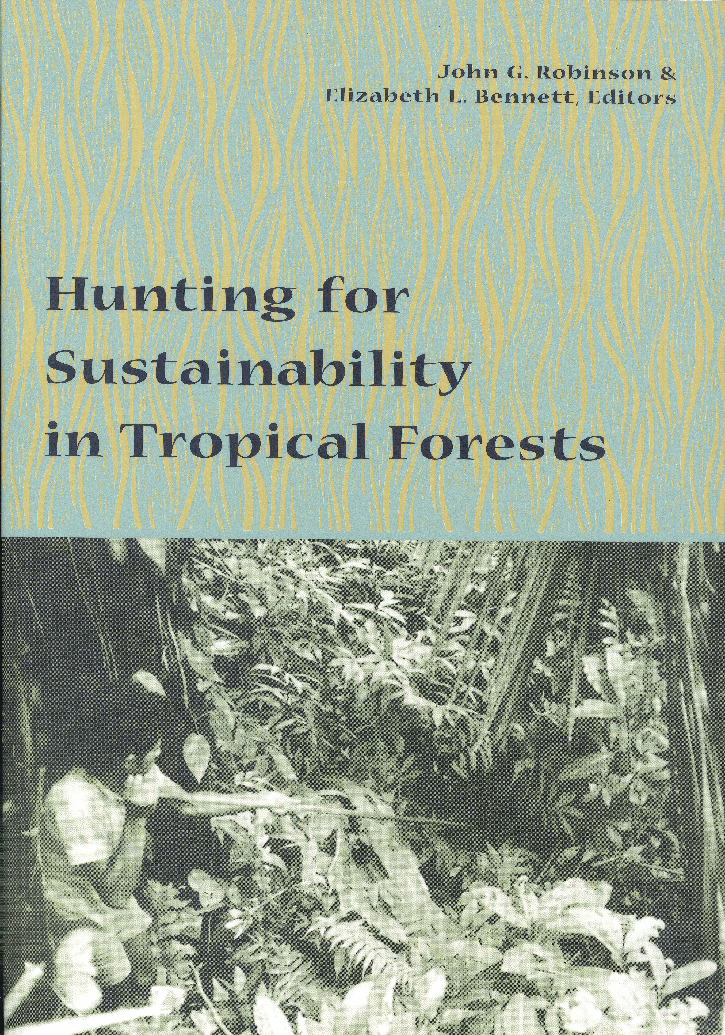
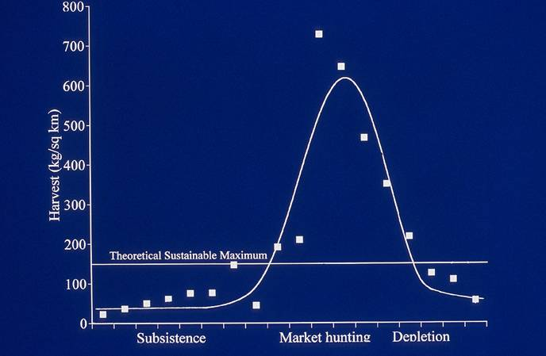
Degree of commercialization
1. A tropical forest can only support one person/km² if they depend on wild mammals for their protein.
2. As hunting is more for sale, we get typical “boom and bust” wildlife trade.

Slide 6
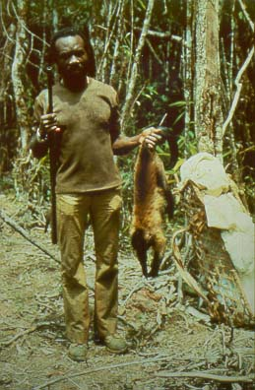
All of this is about wildlife as food, the core concern is sustainability, and we understand a great deal about it.

Slide 7
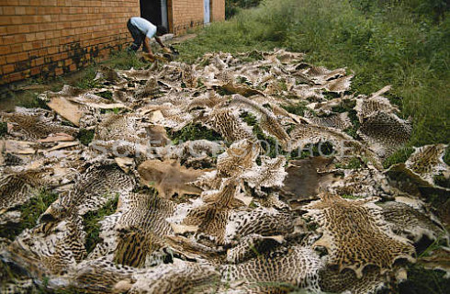
TRAFFICKING
Hunting for long-distance sale. A few, targeted species as pets, or for their parts: pelts, skins, bones. If not ranched, generally unsustainable and illegal.

Slide 8
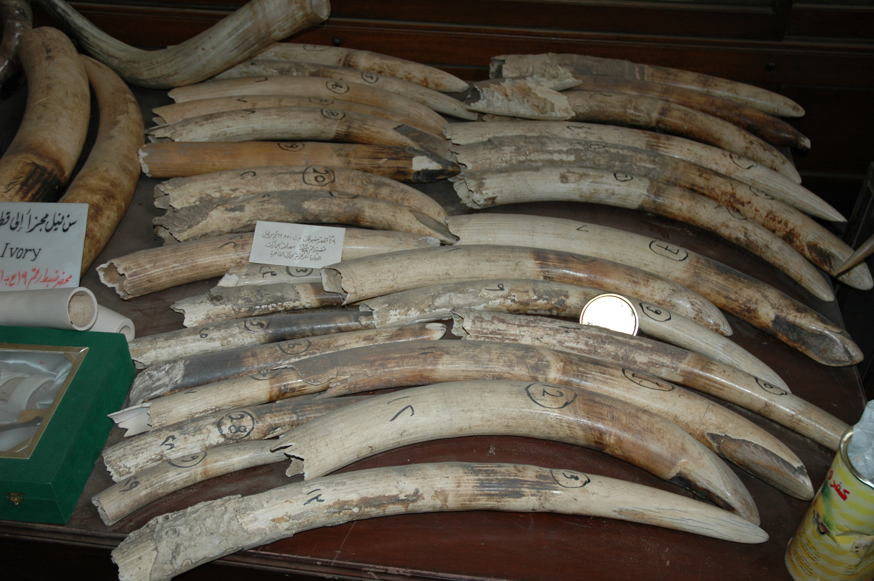
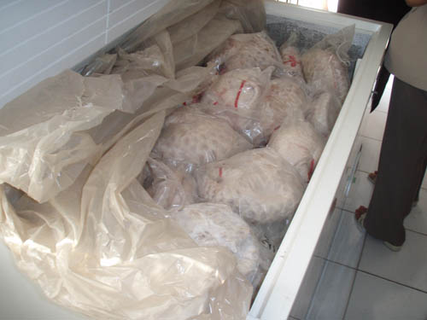
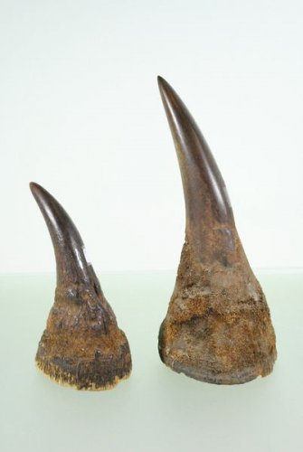
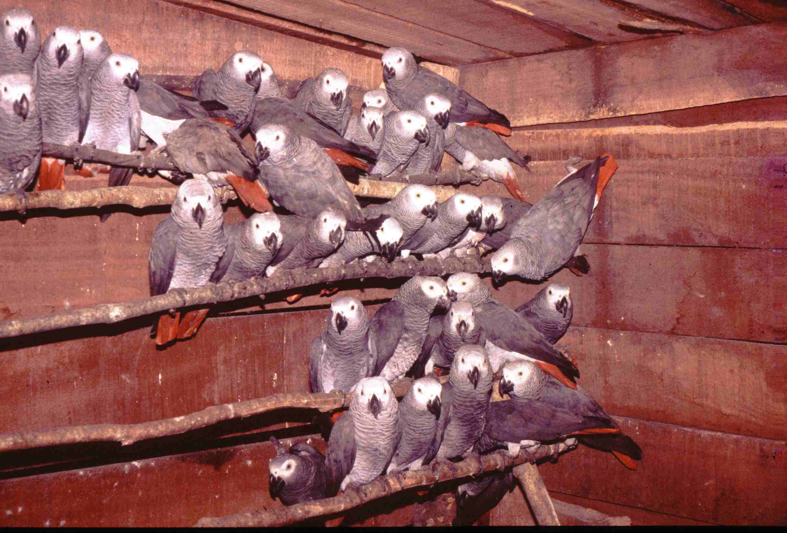
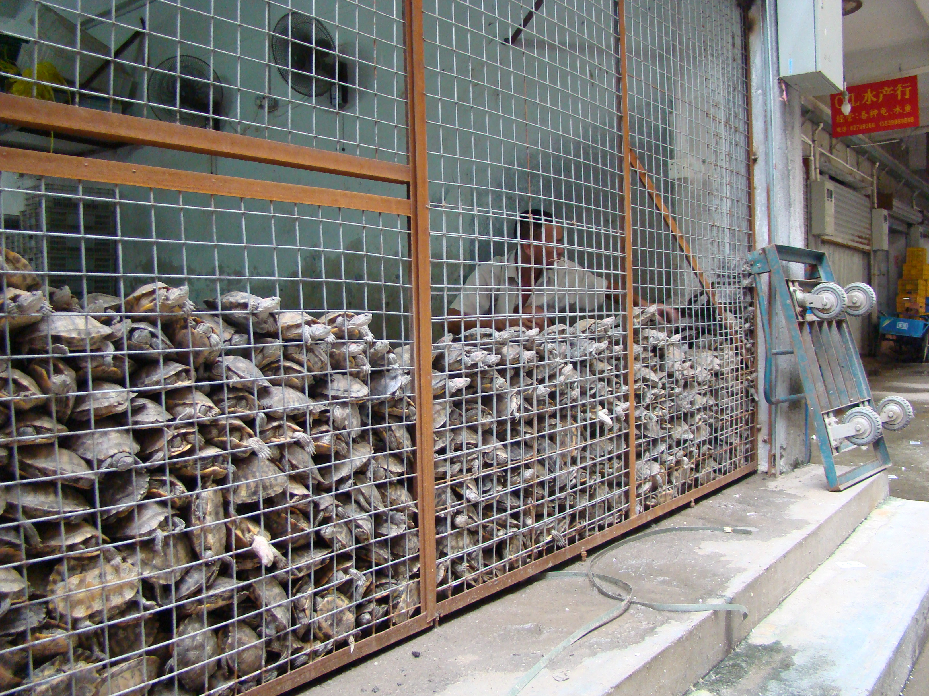
Characteristics of wildlife trafficking:
Illegal;
Long distance (usually international);
Organized (with “kingpins”) and capitalized;
Species (or taxon) specific;
Generally unsustainable.

Slide 9
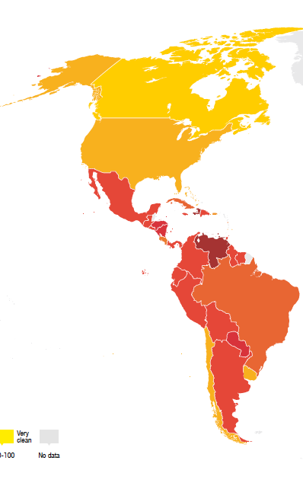
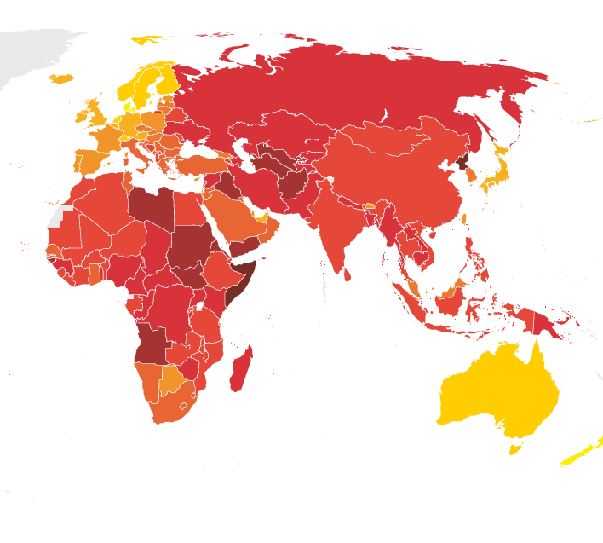
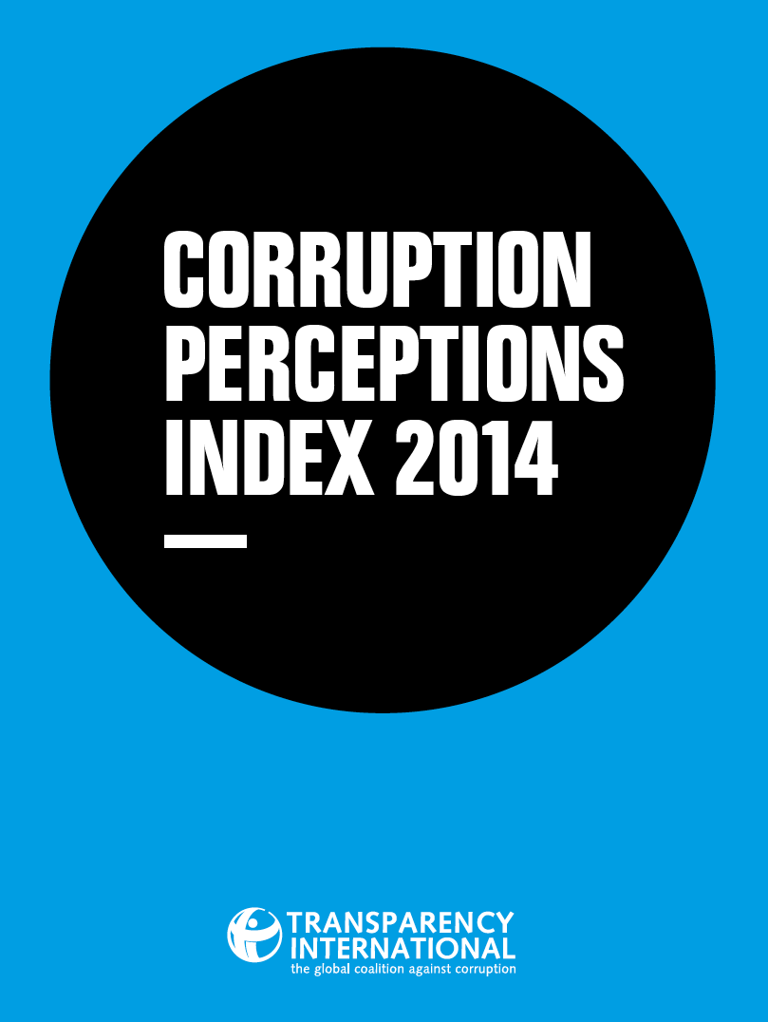
Trafficking often facilitated by corruption at multiple points in the trade chain.

Slide 10
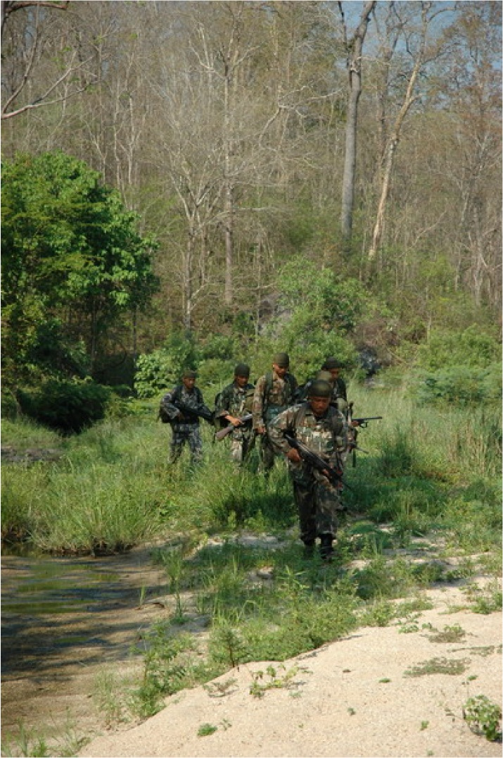
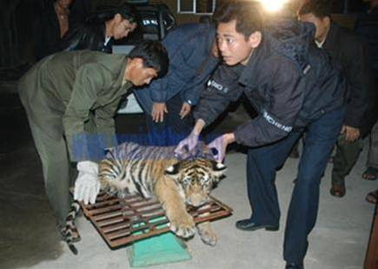
It is sophisticated organized crime, closely linked to other forms of such crime (e.g., drugs, guns).

Slide 11
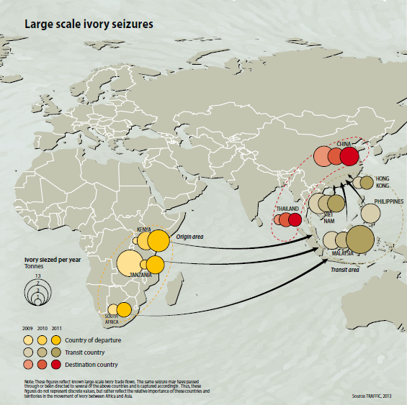
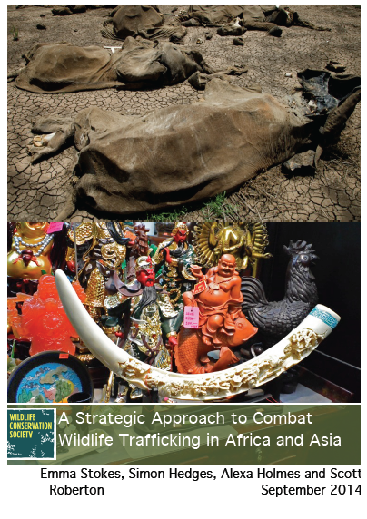
So, what are we doing elsewhere in WCS?
Our core focus was initially Asia, then we expanded to include Africa as the circle of hunting spread – and as Asia’s wildlife declined.

Slide 12
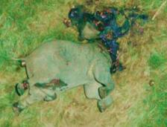
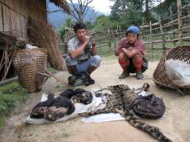
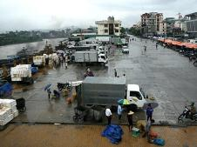
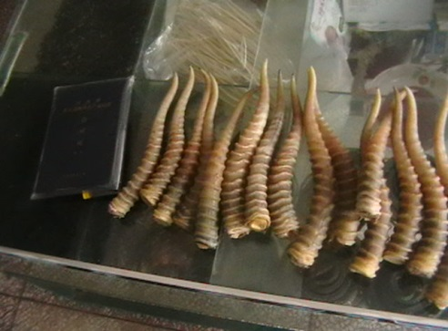
What do we do? Address the problem along the wildlife trade chain, from point of hunting to point of sale
Site
Landscape
Transport nodes
End point
Illegal hunting
Criminal networks
Global transport
Sales
Protected
Areas
Towns and villages in
and around sites
where middlemen
buy and sell wildlife
Where trade flows
converge -
international borders,
ports, airports
Urban areas where
products are sold
to consumers

Slide 13
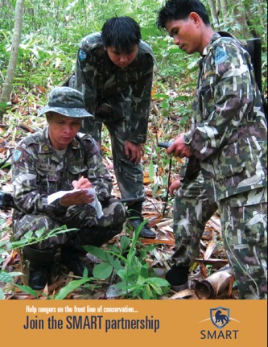
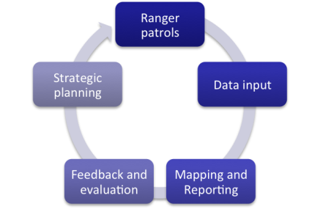
Wildlife trade chain from hunting to sale – Level 1: The Site
Site
Illegal hunting
Protected
Areas
Deployment of SMART - to help site managers better manage ranger enforcement patrols

Slide 14
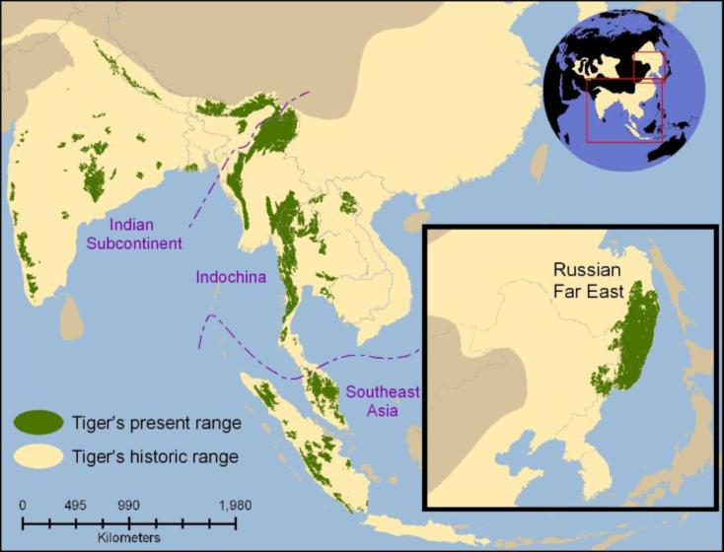
Wildlife trade chain from hunting to sale – Level 1: The Site
Key tiger landscape, western Thailand

Slide 15
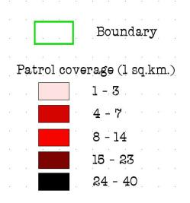
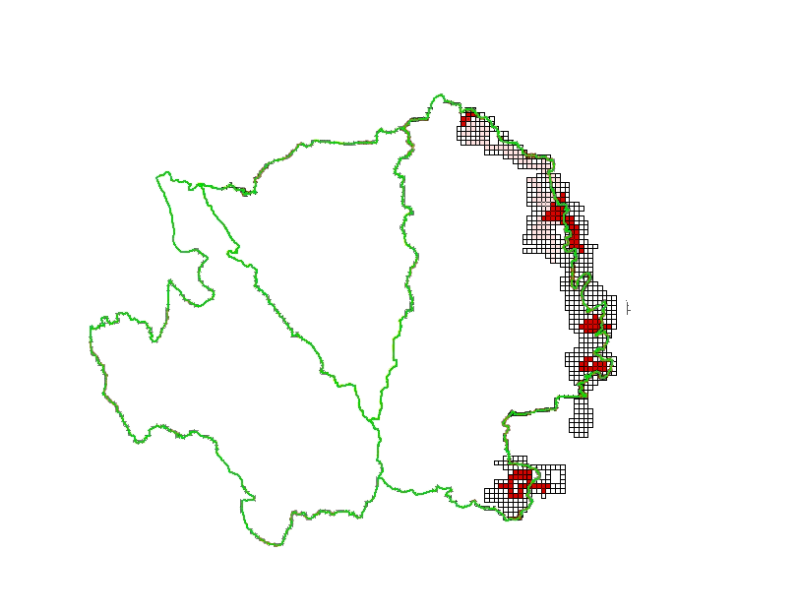
Wildlife trade chain from hunting to sale – Level 1: The Site
SMART PATROLS 2004

Slide 16
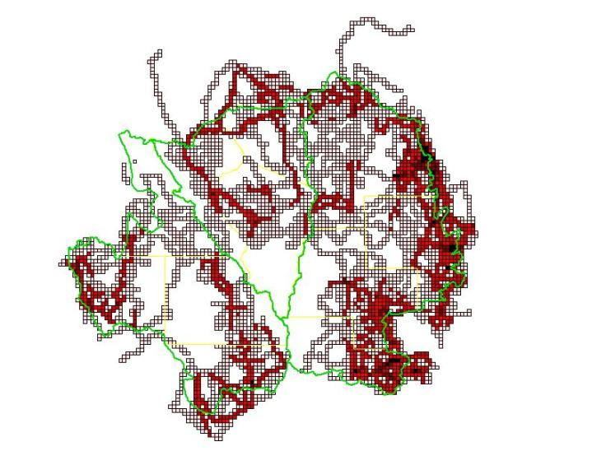
Wildlife trade chain from hunting to sale – Level 1: The Site
SMART PATROLS 2011

Slide 17
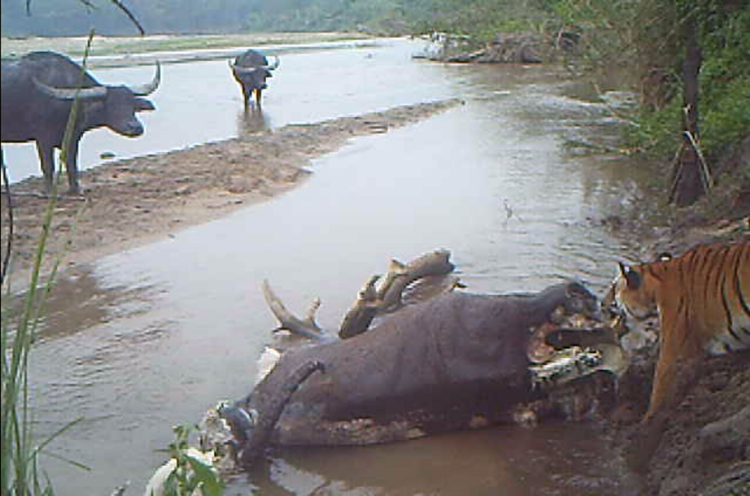
Wildlife trade chain from hunting to sale – Level 1: The Site
Tiger numbers increasing
Key tiger landscape, western Thailand

Slide 18
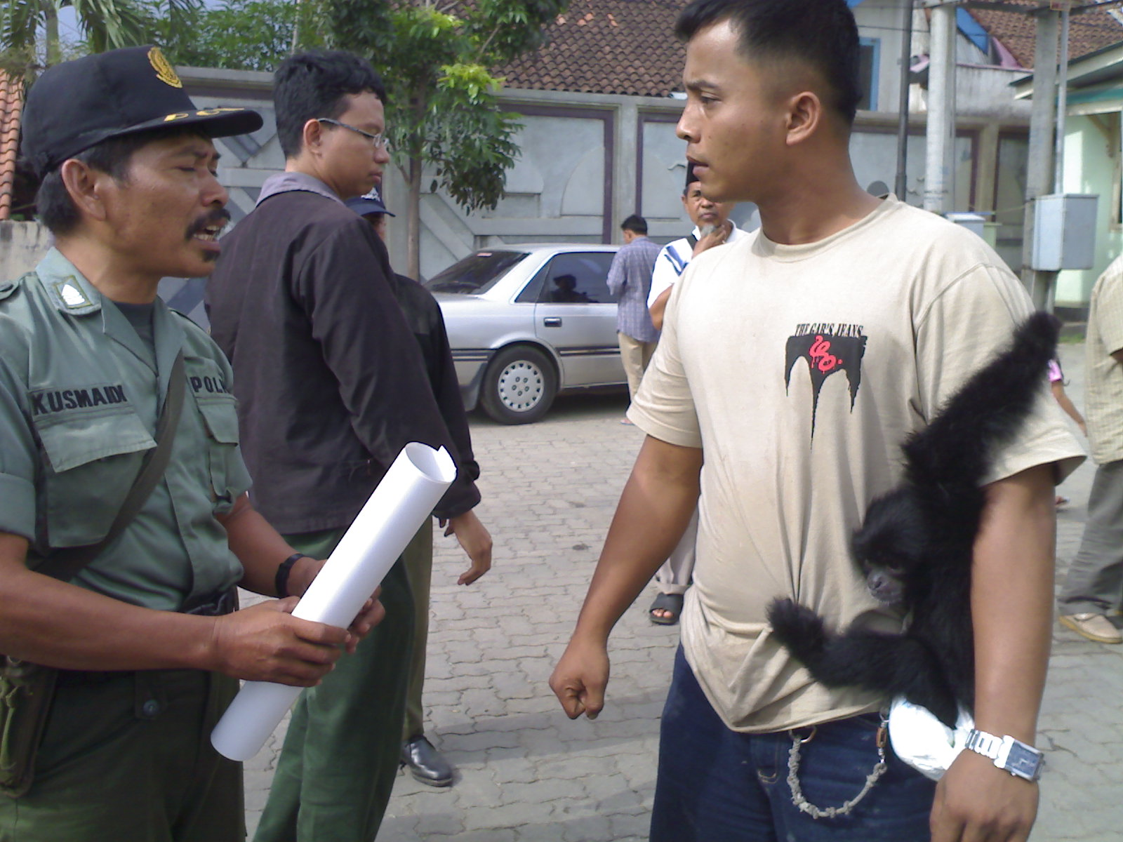
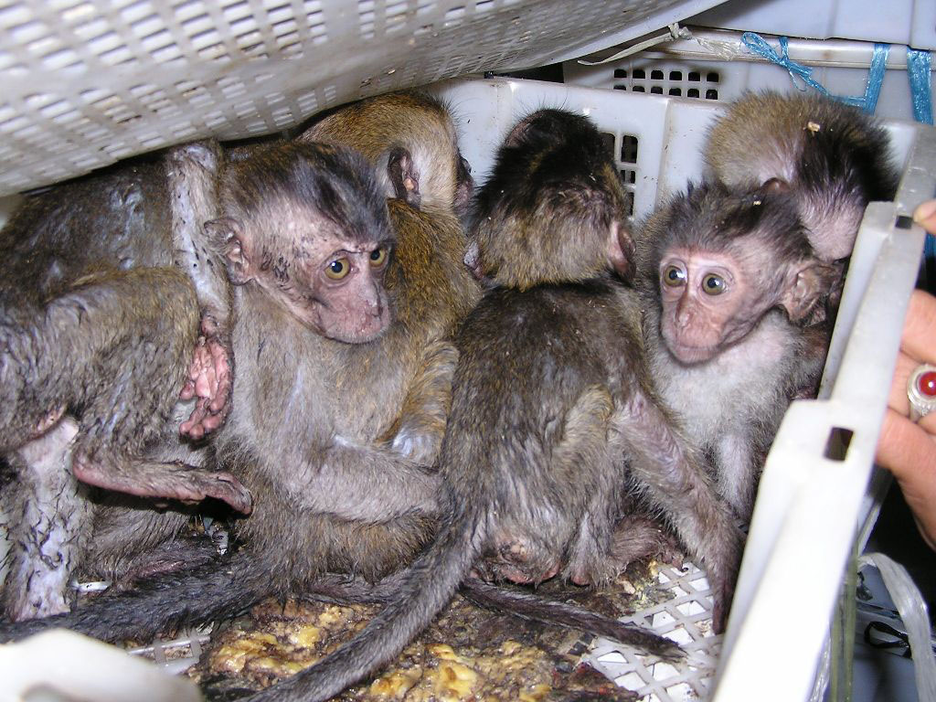
Wildlife trade chain from hunting to sale – Level 2: The Landscape
Landscape
Criminal networks
Towns and villages in
and around landscapes
where middlemen
buy and sell wildlife
Intelligence-led Wildlife Crime Units e.g., across Sumatra, Indonesia

Slide 19
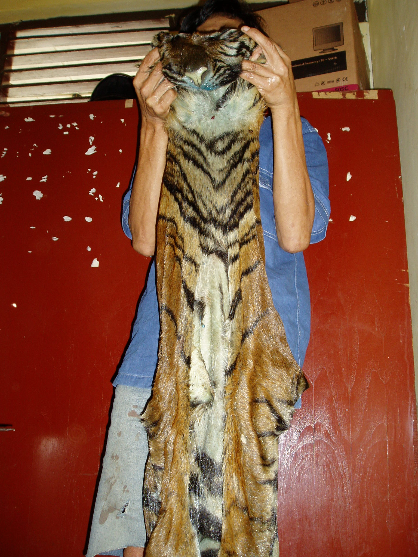
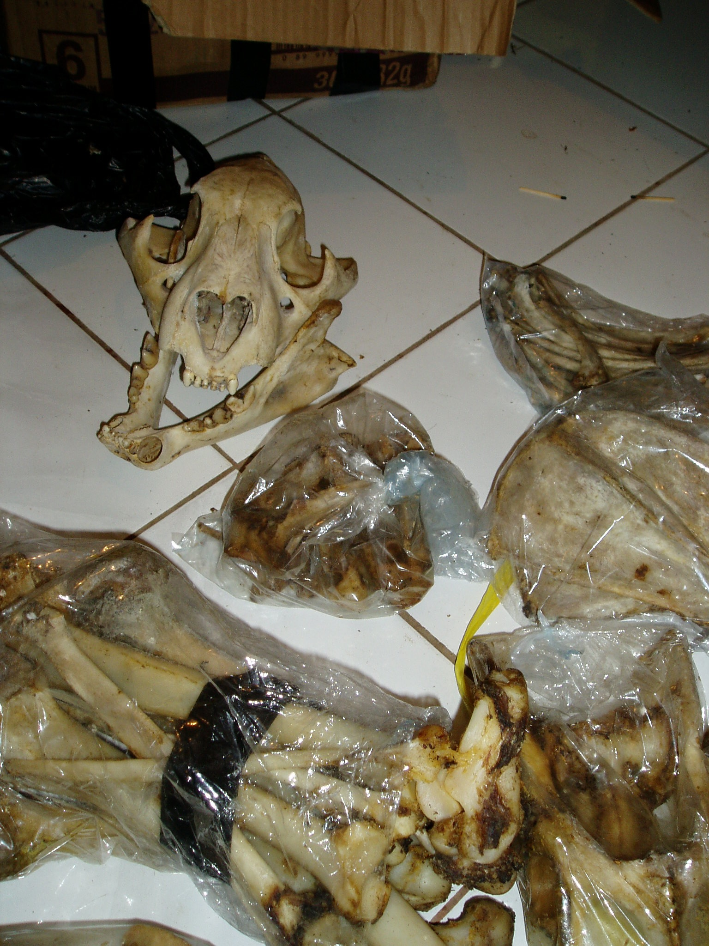
Wildlife trade chain from hunting to sale – Level 2: The Landscape
Wildlife Crimes Units have led to the arrest of 60% of criminals related to tiger syndicates operating out of Gunung Leuser in North Sumatra, and are now focused on the other 40%.

Slide 20
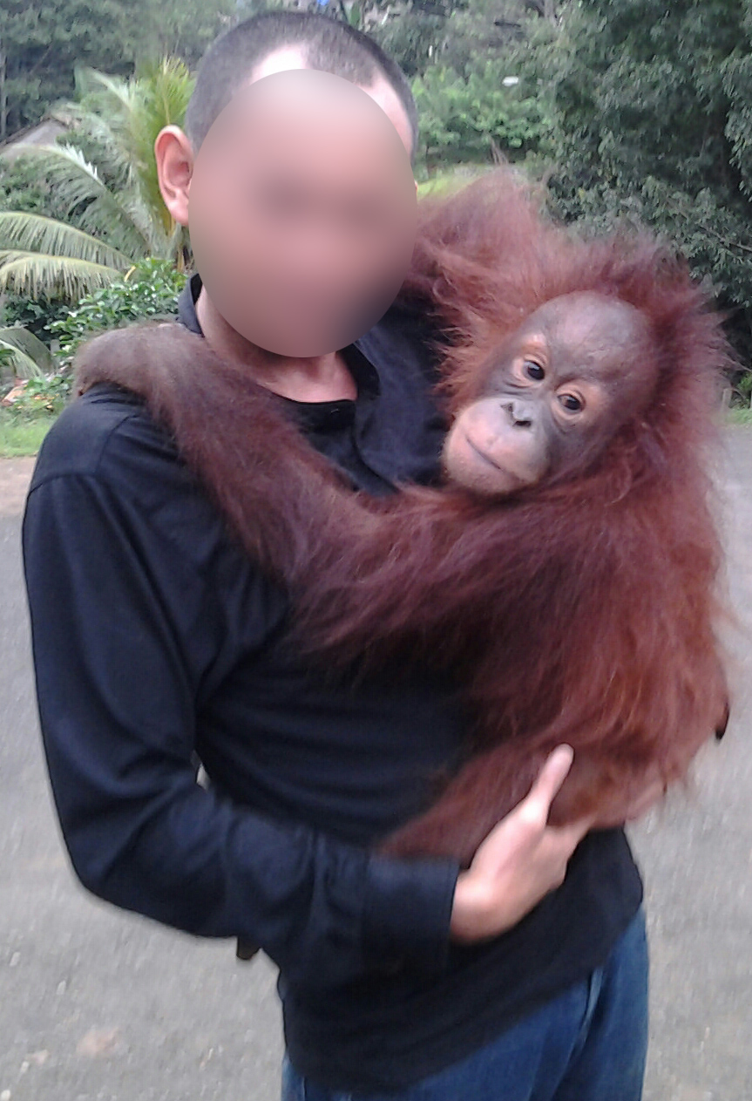
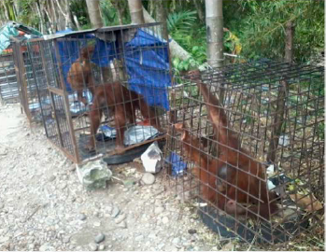
Wildlife trade chain from hunting to sale – Level 2: The Landscape
July-Dec 2014, WCS catalyzed the arrests of 7 known orang-utan traders, with convictions and jail time for 2.

Slide 21
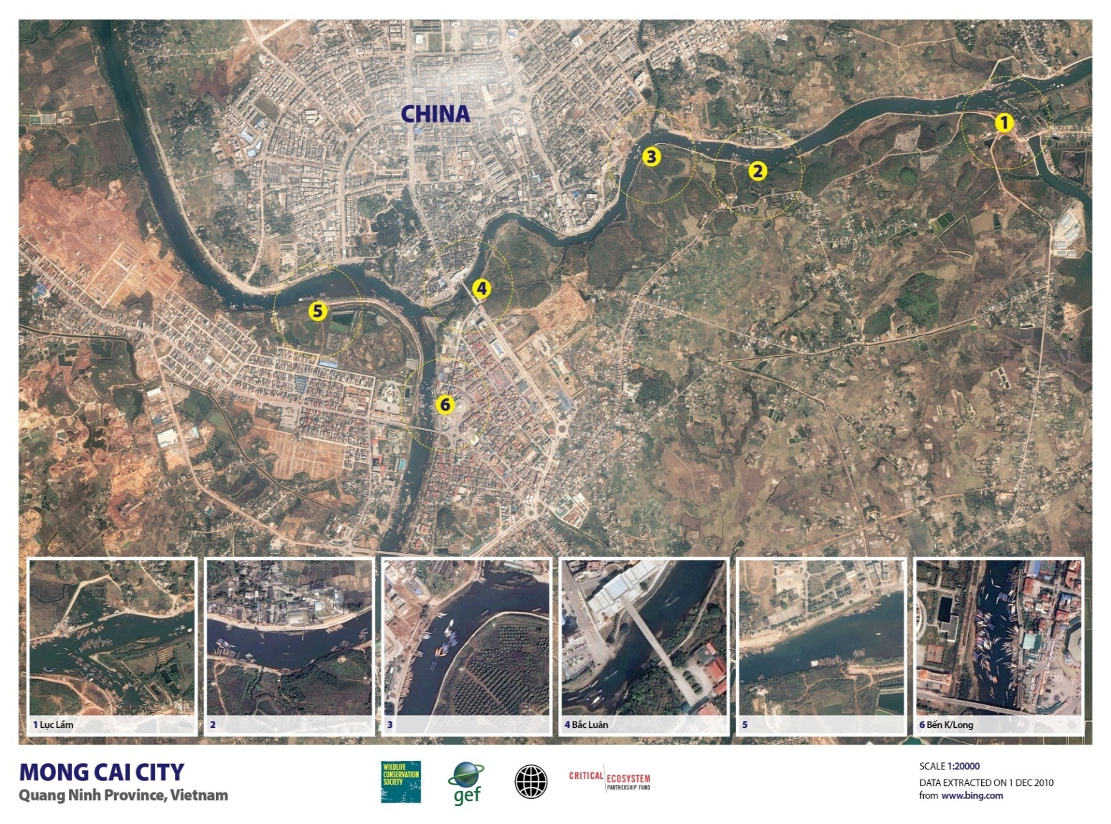
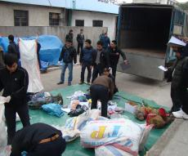
Wildlife trade chain from hunting to sale – Level 3: The Transport Nodes
Transport nodes
Global transport
Where trade flows
converge -
international borders,
ports, airports
Working with law enforcement partners e.g., at a key Vietnam/China border crossing

Slide 22
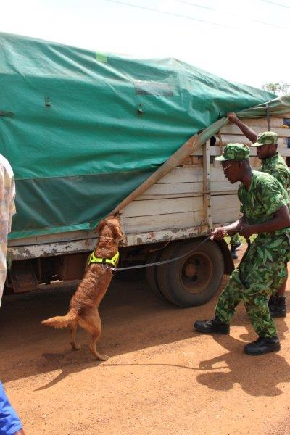
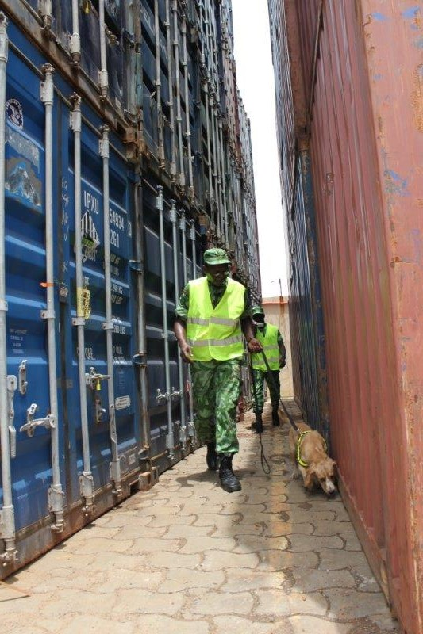
Wildlife trade chain from hunting to sale – Level 3: The Transport Nodes
Deploying ivory-detection sniffer dogs at key ports and airports

Slide 23
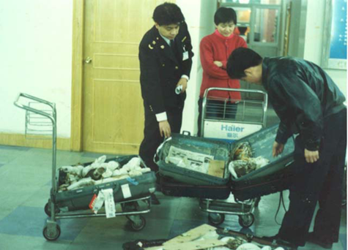
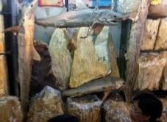
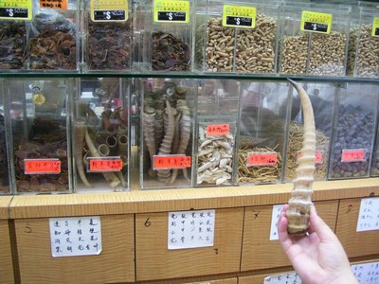
Wildlife trade chain from hunting to sale – Level 4: The End Points
End point
Sales
Urban areas where
products are sold
to consumers
Working to increase detection and enforcement at Customs and markets in southern China

Slide 24
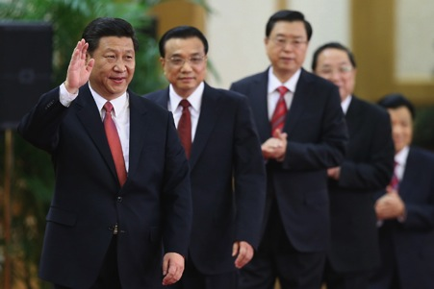
Wildlife trade chain from hunting to sale – Level 4: The End Points
Influence senior leaders. Strong government action leads to major behavior change.
Influence public perceptions. Reducing demand is critical.

Slide 25
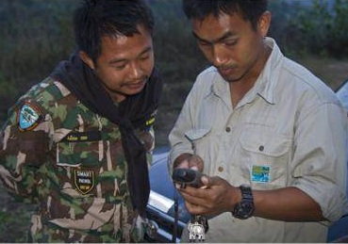
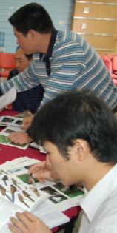
At all levels: Working to strengthen enforcement capacity
Site
Landscape
Trade nodes
End point
Strengthen enforcement capacity: Provide training and support to front-line enforcement staff.
Institutionalizing training programs into the curricula of key agencies
New technology for enforcement officers e.g., identification apps

Slide 26
At all levels: Working to improve efficiency of the legal process
Site
Landscape
Trade nodes
End point
Improve efficiency of the legal process: Provide training, awareness-raising and support to judiciary, prosecutors, media.
WCU Indonesia successful prosecution rate, against a national background of 5%

Slide 27
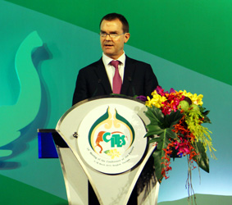
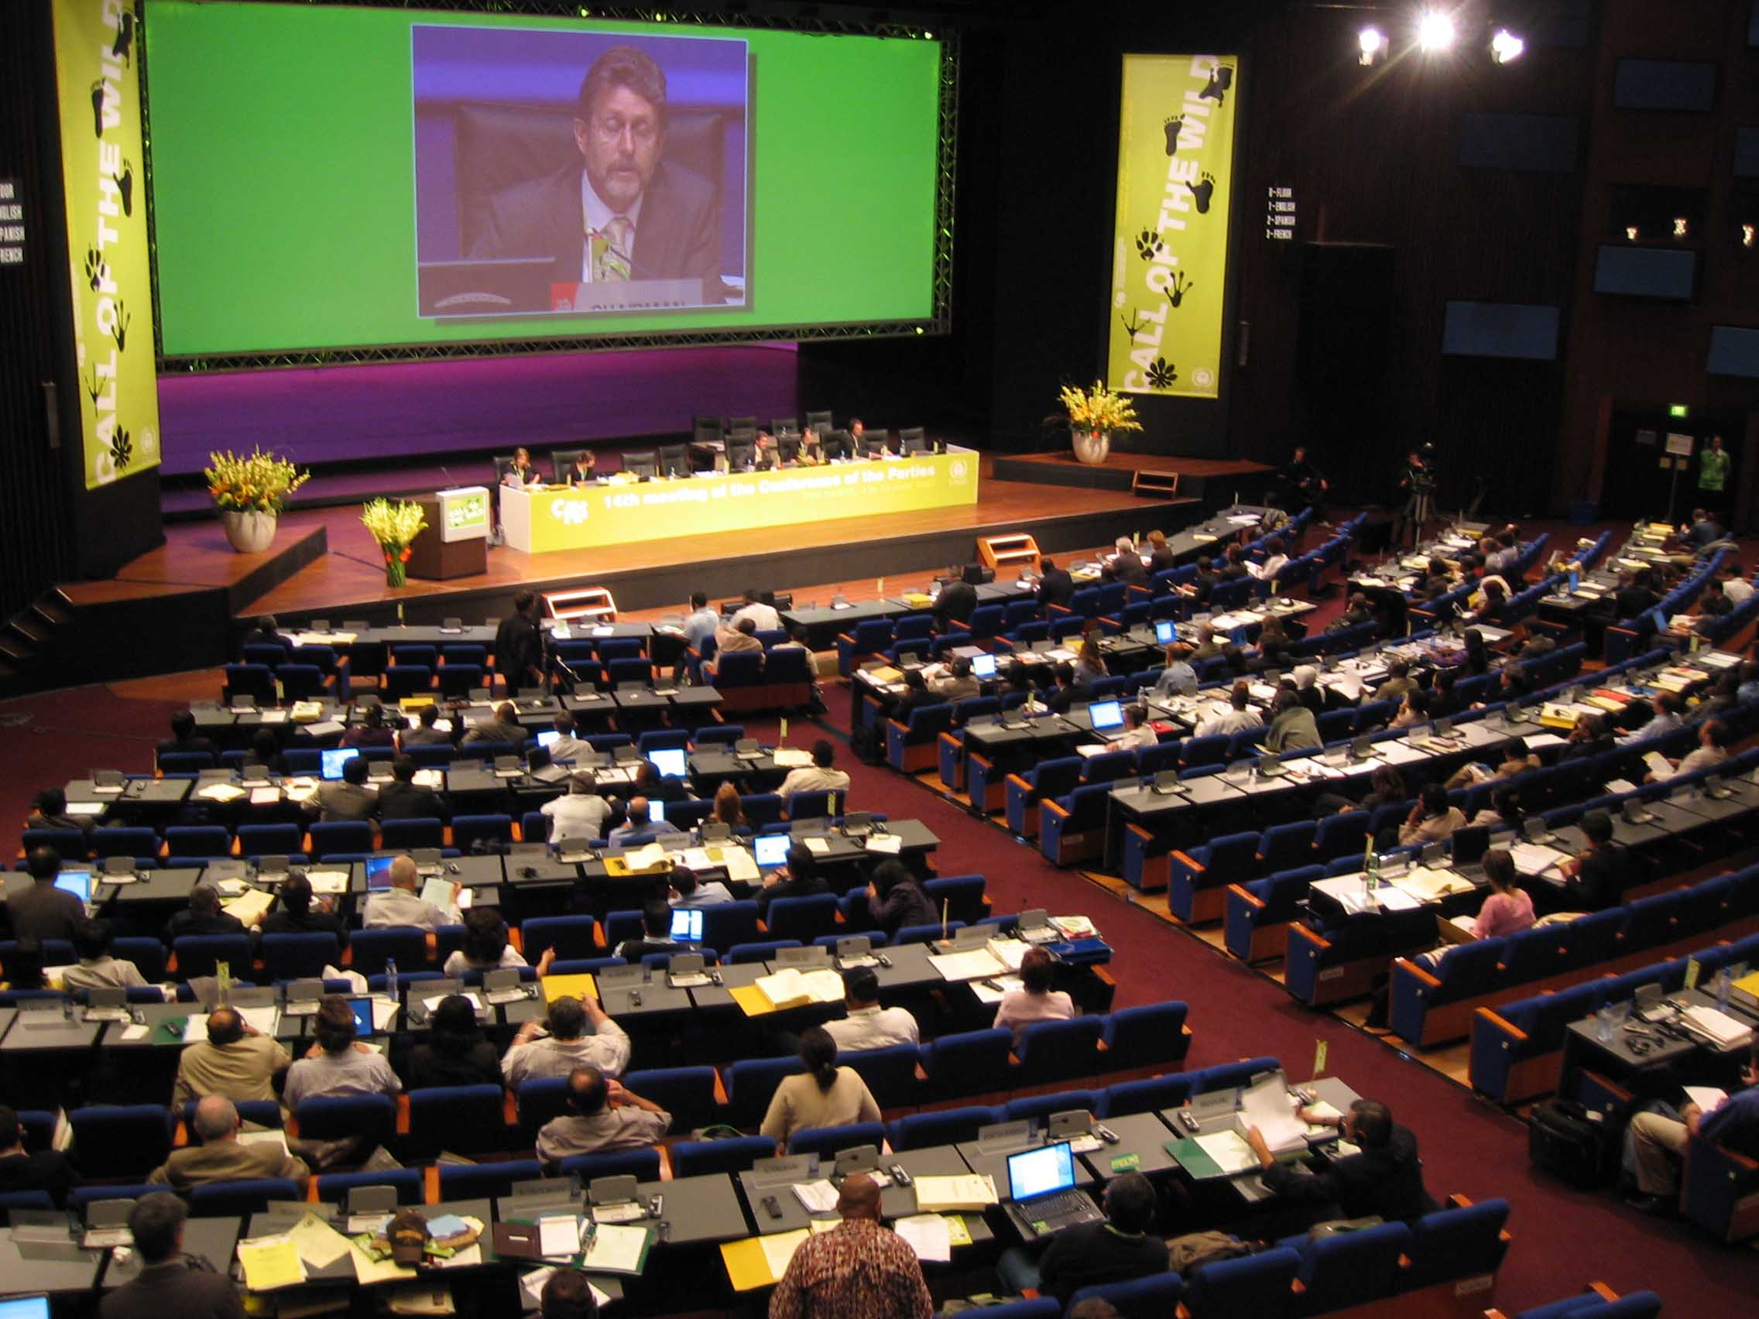
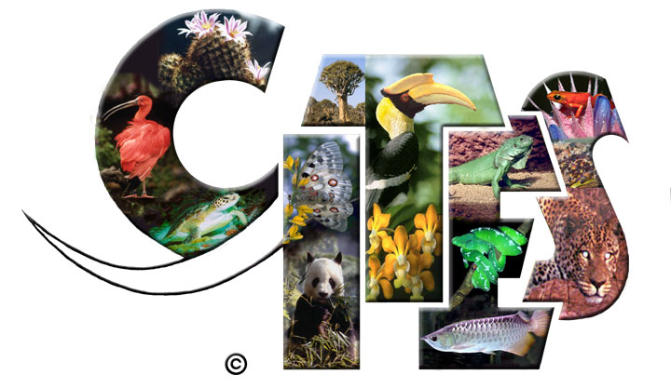
At national and international levels: Working to improve policies and laws
Latin American countries have a very important global influence!

Slide 28
At national and international levels: Working to improve policies and laws
We do a lot of this!
Key players within WCS: Cristián Samper, John Robinson, John Calvelli, Sue Lieberman, Liz Bennett, Simon Hedges, Scott Roberton, Emma Stokes

Slide 29
Two linked challenges face Latin America:
Other parts of the world have greatly depleted populations of targeted species (e.g., big cats, bears, turtles);
Increasing spread of links to markets of East Asia.
What can be done to make systems resilient?

Slide 31
Thank
you!

