Slide 1
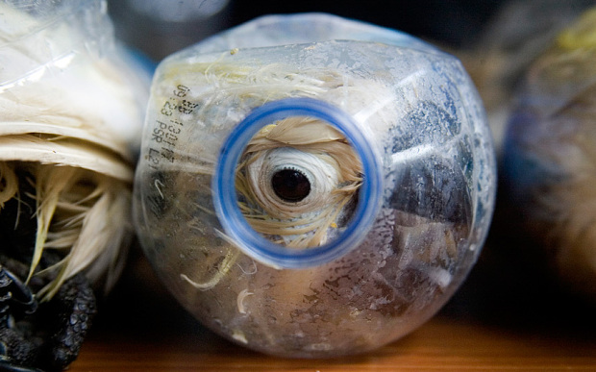
REGIONAL WILDLIFE TRADE TRENDS AND ISSUES Manado, 20th May 2015
Notes:
Thanks

Slide 2
What are we going to do?
Test a few myths about wildlife crime, and describe global, national, and local trends.
Talk about some research findings, challenges and opportunities
Propose a few ideas for next steps in Indonesia.

Slide 3
GLOBAL TRENDS

Slide 4
BROAD GLOBAL TRENDS
$10bn a year.( Wilson-Wilde, 2010)
Prices appear to be rising
Demand is rising, and diversifying.
New markets are being created – new middle class in Asia and Africa
Increasing sophistication, decreasing visibility
Wildlife criminals are professional, organised, cooperating internationally, and innovative

Slide 5
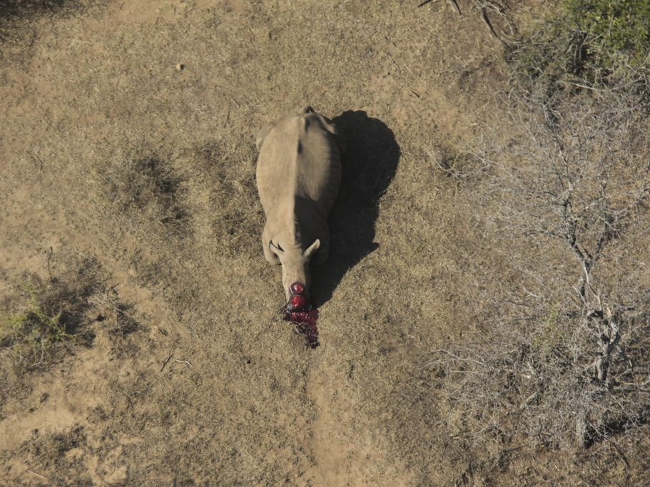
THE RHINO PARADOX

Slide 6
REGIONAL TRENDS

Slide 7
Market values ($)
Rhino horn
$2000-$6000
Gold
$4800
Tiger bone balm
$850
Heroin
$1500-2000
Elephant ivory
$50-$700
Golden Turtle
$300-$500
Amphetamine
$100
Opium
$50
Pangolin scales
$200-400
Beef
$0.75 - $1
Per 100g
Notes:
Mirror global trends

Slide 8
WILDLIFE CRIME AND TRADE IS ONLY AN ASIAN PROBLEM….

Slide 9
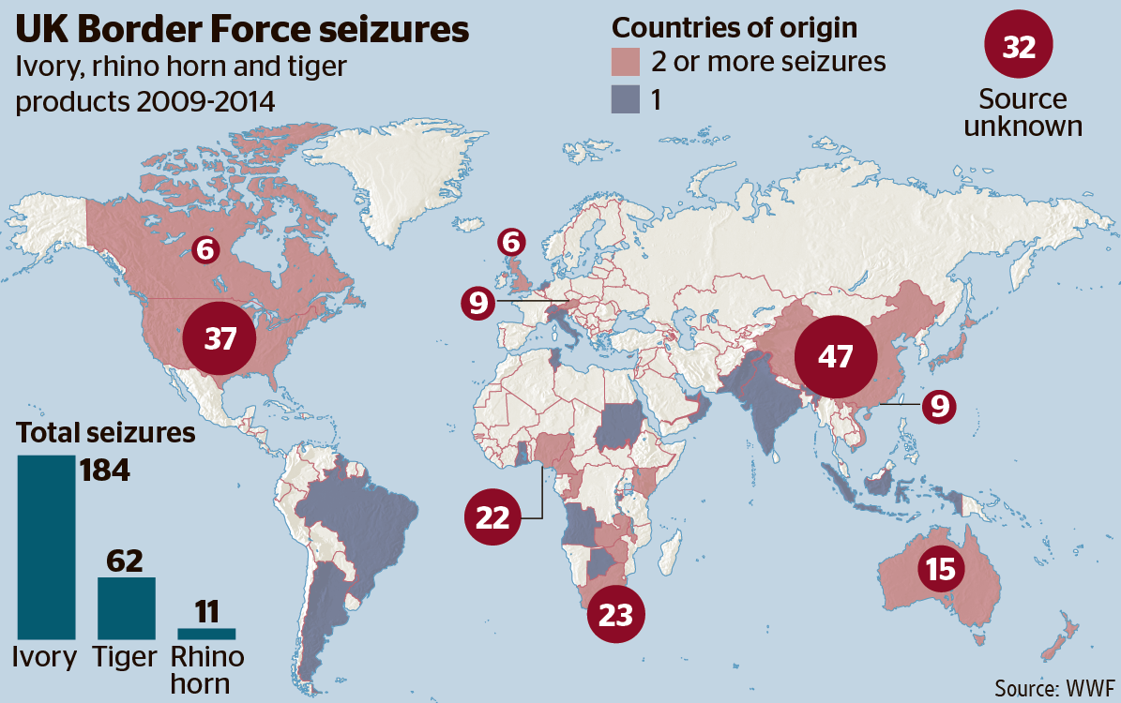
USA and Europe are critical MARKETS
New York, $2m of ivory seized in 2012.
JFK airport – 1.4 billion tons of freight…
but only 6 inspectors and 4 police agents
Notes:
And Growing middle class in Africa and Asia are driving home-grown demand.

Slide 10
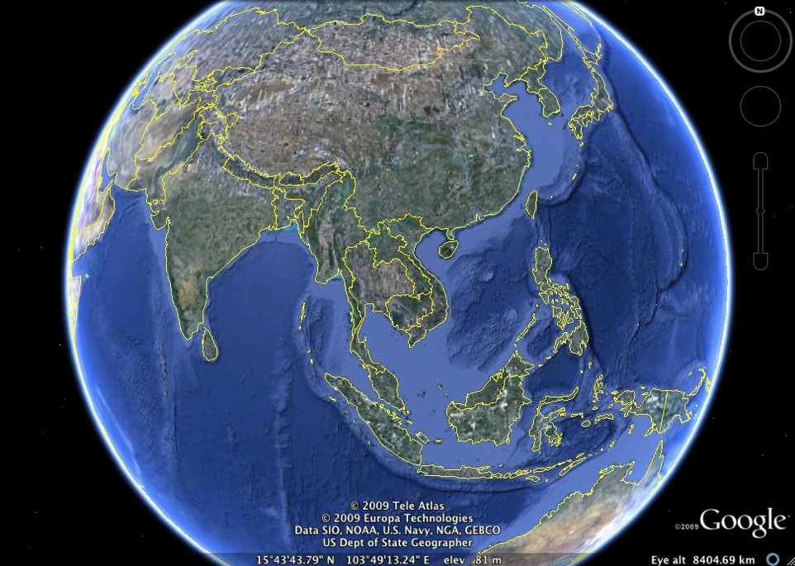
BUT IN ASIA, MARKETS ARE TRANSNATIONAL

Slide 11
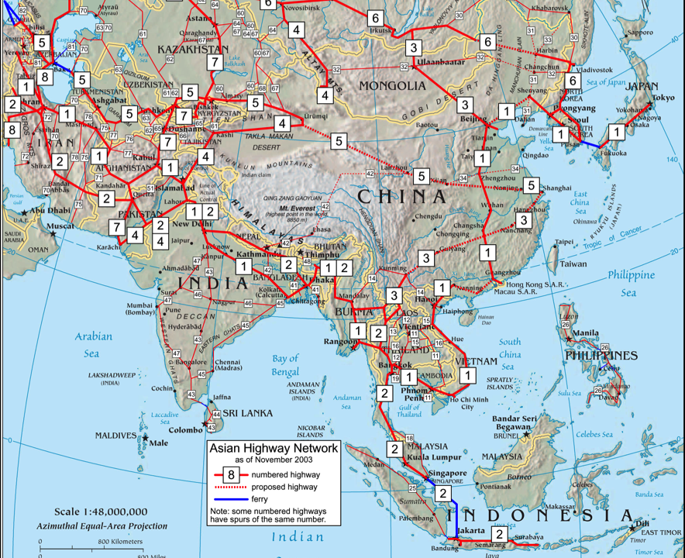
….FACILITATED BY ROAD NETWORKS

Slide 12
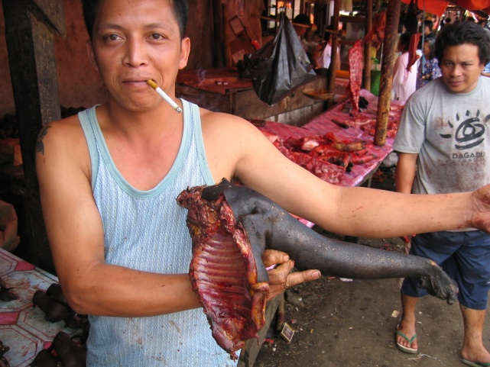
AND ARE EVOLVING FROM THIS…

Slide 13
….TO THIS

Slide 14
WILDLIFE CRIME IN ASIA ONLY AFFECTS A FEW SPECIES….

Slide 15
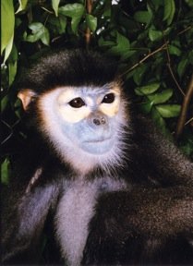
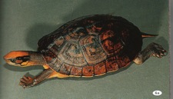
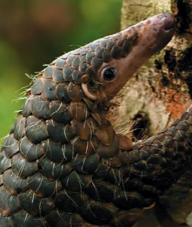
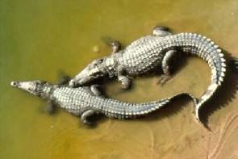
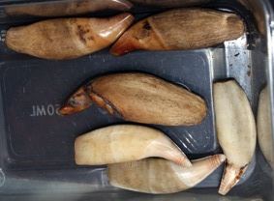
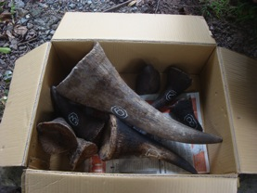
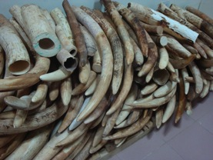
A huge variety of species are traded in SE Asia, from every species group.
1/3rd of all bird species, and thousands of mammal and reptile species are globally traded (Nijman, 2010)

Slide 16
…On an industrial scale
China (2003) - 31 Tigers, 581 Leopards, 778 Otters

Slide 17
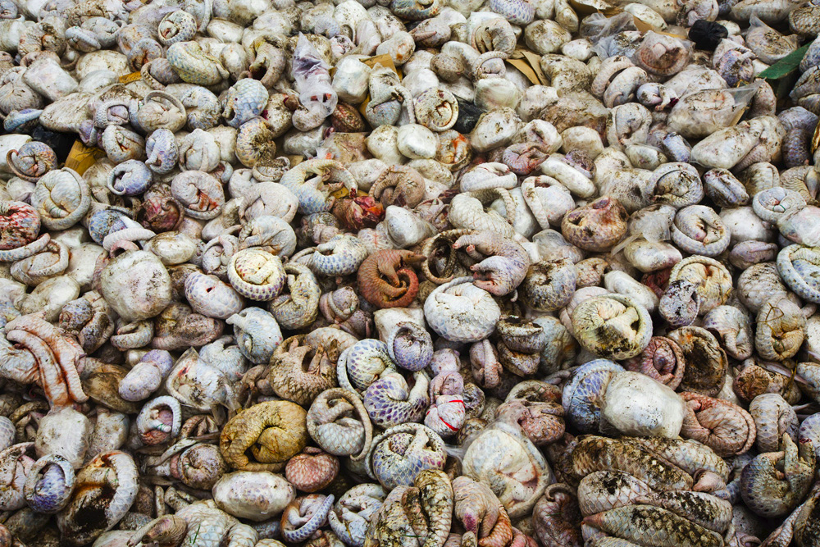

Slide 18
POACHERS FOR THE INTERNATIONAL TRADE ARE POOR PEOPLE TRYING TO MAKE A LIVING

Slide 19
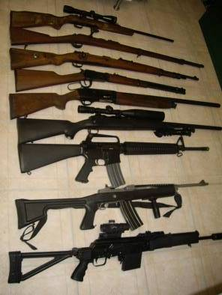
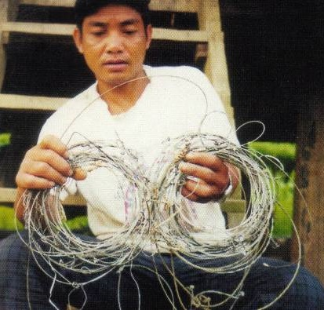
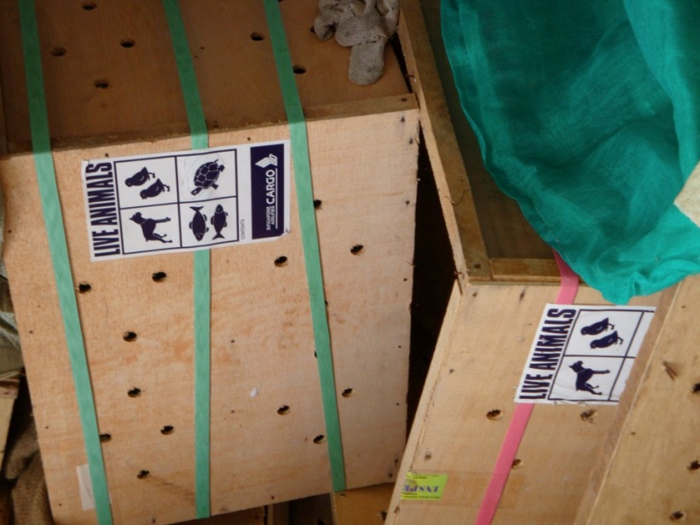
A modern (illegal) supply chain

Slide 20
EXPORT
Illegal crossing points
National hunters
Wholesale wildlife traders
Wildlife in Indonesia's forests
Legal border gates
Smuggled
Wildlife in forests of other countries
Fake permits
Hunters in other countries
Indonesian retailers:
Restaurants
Pharmacies
Pet Shops
Jewelry shop
Indonesian Consumers
Notes:
Illegal cross-border trade in wildlife from Vietnam to China highlighting on routes wildlife moves from the forest to the markets in China

Slide 21
WILDLIFE CRIME IS AN ENVIRONMENTAL PROBLEM….

Slide 22
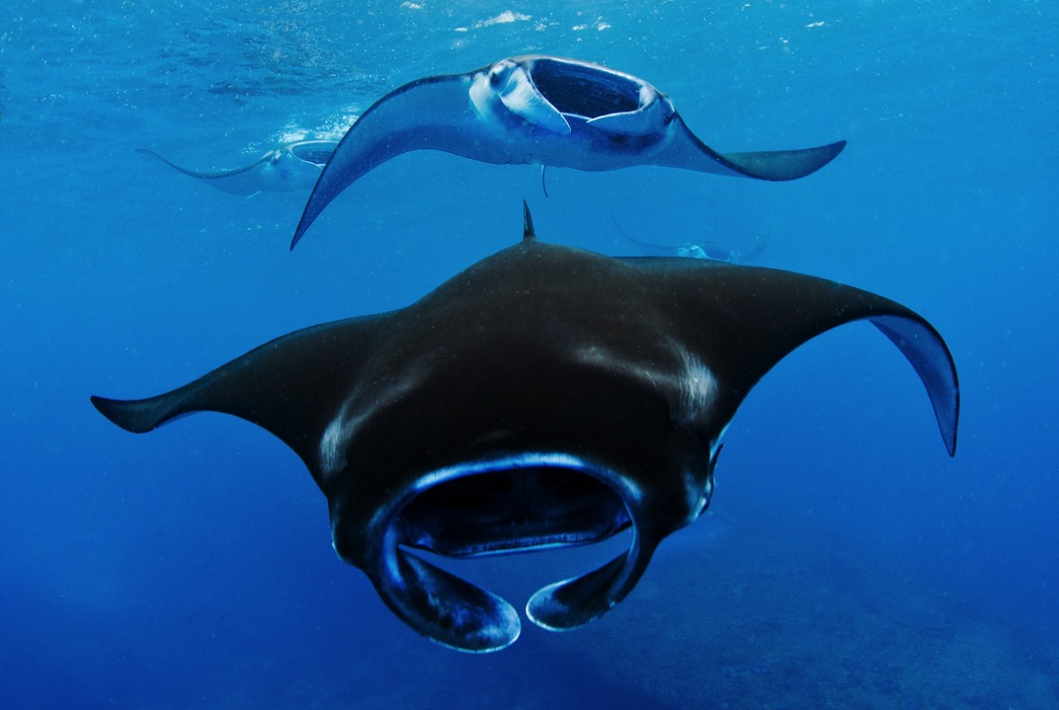
Far reaching impacts
Disease transmission (SARS, Avian flu)
Manta rays value 2000 times greater for tourism alive than dead for fisheries products (c. $2m)
Corruption
Loss of ecosystem
services
Weakening the rule of law
Economic losses (taxation)

Slide 23
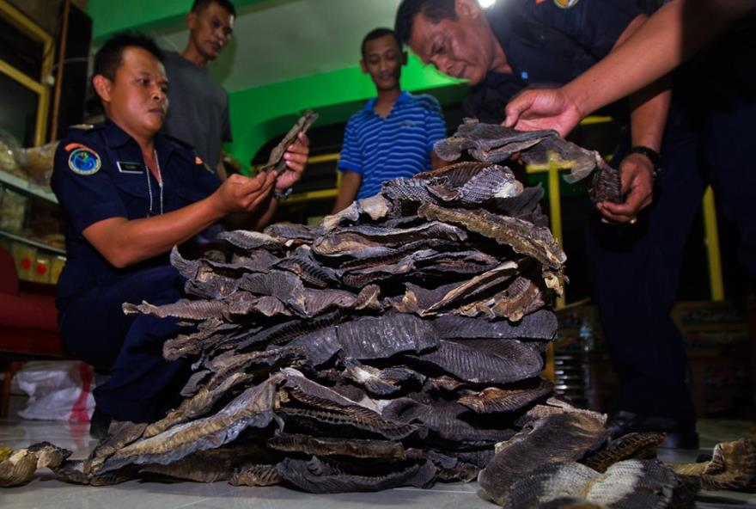
Indonesian trends and challenges

Slide 24
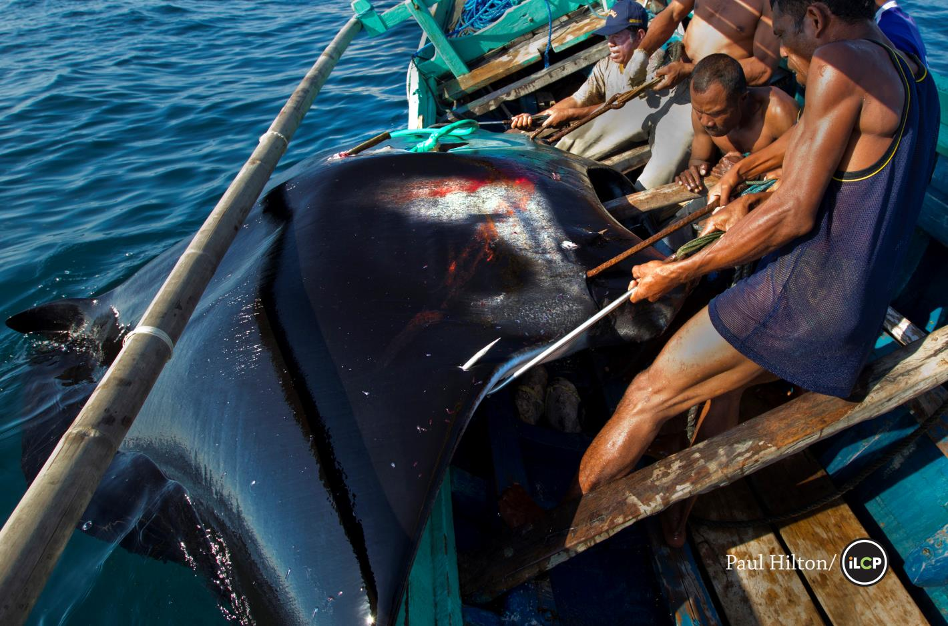
current knowledge

Slide 25
TRADE VOLUMES + DEMAND: KEY TRENDS
Data is very species specific and/or site specific, so accurate national or provincial scale assessments are currently impossible.
All signs (expert respondents, seizures, observations) indicate illegal wildlife trade in Indonesia is rapidly increasing, in line with increasing domestic/regional/global demand.
Domestic demand is key for some species – particularly birds. In 2008, poaching rates for parrots from North Halmahera, Maluku were an estimated at just under 1000 birds annually , 41% for export (Philippines), and 59 % for domestic trade.
When trade in one species appears to fall, it usually reflects a switch to a different species. The trade in Indonesia is very dynamic..
Trade in tigers, hornbills, elephant ivory, pangolins and other species is estimated to have increased four fold since 2010 according to respondents.
4

Slide 26
Indicators of VOLUME
81,689
Number of pig nosed turtles seized in Indonesia between 2003-2012 destined for export (2012)
1,320
Number of manta rays in Indonesia killed annually for their gill rakers before the ban (2012).
3-5
Number of live Sun-bears exported per day from Indonesia (2008)
1260kg
The ivory sales from a single trader in Lampung since 2003 – equivalent to 47 elephants (2014)
55
Number of tiger related cases investigated by WCS Wildlife Crime Unit since 2003 (2015)

Slide 27
Indicators of volume
5,000
Number of helmeted hornbills poached between 2012-2013 across Indonesia (2014)
714
Number of slow loris (Nycticebus coucang) observed for sale in 2 markets in Medan between 1997-2008 (2008)
A single shipment of pangolin scales observed in Sumatra in 2008. Equivalent shipments are thought to be leaving Sumatra each month. One kilo of pangolin scales is equivalent to 4 animals (2008)
25t

Slide 28
CASE Studies - sulawesi
Wildlife passing through Sulawesi often destined for the Philippines
NGO investigators recorded hundreds of Indonesian species at markets, pet shops, zoos in Manila, General Santos, Davao, and other towns in Mindanao (2002)
Bornean orangutan, gibbons and sun bears were seized by North Minahasa police from a smuggler attempting to reach Bitung to board a ship to the Philippines (2004)
Forestry police seized a critically endangered Javan Leopard from a smuggler seeking a buyer in the Philippines. Later returned to Java (2006)
Talaud Police seized 111 Red & Blue Lories from a man attempting to board a ship to the Philippines (2013)
Bitung police seized a Sumatran Sun bear ready for shipping, reported tigers had already gone (2014)

Slide 29
MARKET CHARACTERISTICS: KEY TRENDS
Wildlife trade is increasingly well organised – visibility is declining though still relatively open compared to many countries.
There are reports of hunters being equipped and funded by buyers/traders to collect specific species – ‘poaching to order’
Online trade is growing rapidly in response to limited enforcement capacity.
Wildlife traders are increasingly using disconnected network systems, like drug traffickers, as well as unidentified methods to get through custom exit points.
ü
@@@
A
B

Slide 30
MARKET values
$194 - $6,400
Per bill cost of ‘red’ hornbill ivory in Indonesia, and the per kilo cost of hornbill ivory in Chinese markets – 5x higher than elephant ivory
$16,000
Value of an Indonesian Palm cockatoo
(Probosciger aterrimus) on the international market.
$6,000,000
Value of shark fins extracted from West Nusa Tenggara in 2012 on the international market (434t).
Value of an orangutan in Indonesia, and its international market price. WCS WCU has investigated 85 cases involving 545 live primates since 2003..
$50 – $45,000

Slide 31
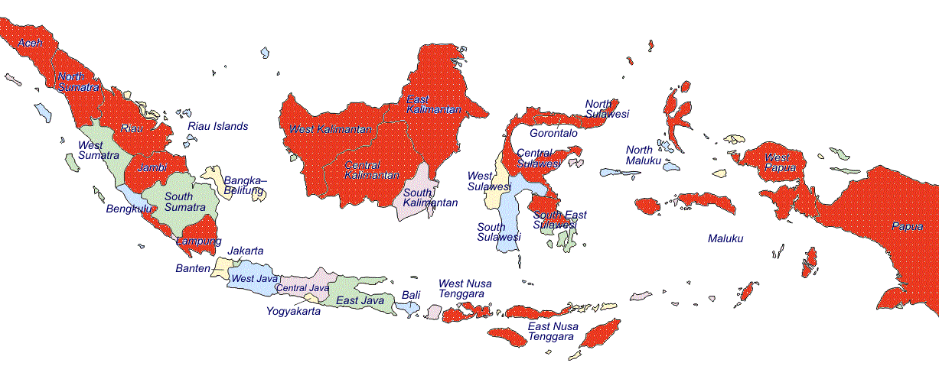
Extraction areas
Extremely high extraction rates indicated from almost all areas in Indonesia: (see red provinces below:
But, data is deficient on specific volumes and scale of the trade in all areas.

Slide 32
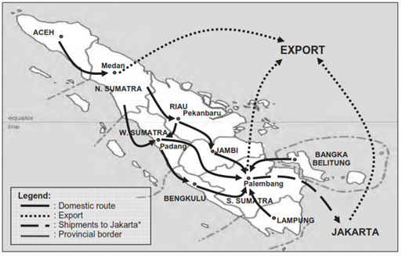
Trade routes
Trade routes within Indonesia are complex, involve multiple steps, and are very species specific.
Pangolin trade routes in Sumatra are shown below.

Slide 33
Key challenges

Slide 34
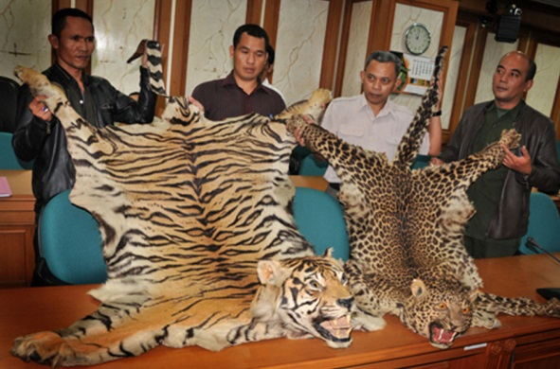
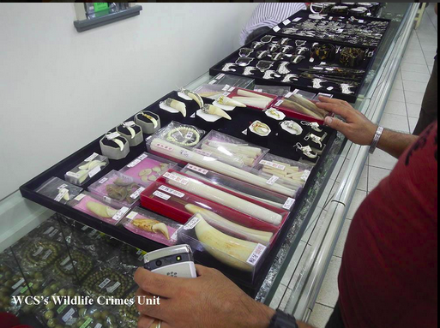
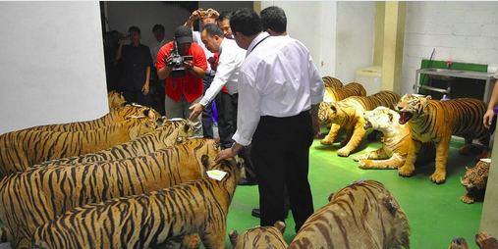
Legal Scope
Implementation and enforcement
Detection and Reporting
5 challenge clusters identified
Registration and prosecution
Arrest and Detention

Slide 35
EXAMPLE: Legal Scope - Identified Challenges
Legal Scope
Revision of GR No.7/1999
GR No. 7/1999 fails to protect CITES listed species, and other species that are of critical conservation concern in Indonesia.
Reform of Act No.5/1990
No provisions for non-native species protected under CITES (e.g. African ivory).
Limited legal protection of species outside protected areas – no connection of species protection to critical habitats.
Enforcement powers of forestry investigators are limited
The CITES management authority for marine species is currently MoEF – and marine species have insufficient focus. This could be revised

Slide 36
EXAMPLE: Legal Scope - Possible actions
Legal Scope
Revision on species protection – GR. No.7/1999, to align with CITES as a minimum.
Revision of penalties: higher fines – max./min. sentences
Removal of various exclusion clauses (wildlife as gifts)
Increase authority of forestry and civil investigators and increase their powers of arrest and investigation
Allow prosecution of civil suits – e.g. enable legal action to be taken against government officers for failure to enforce existing legislation.
Online trading of wildlife trade – e.g. allowing photos, videos and online as admissible evidence in wildlife crime cases.
Link protected species with their habitats on GR No.7/1999.

Slide 37
OTHER IDENTIFIED CHALLENGES
INVESTIGATIONS
ARRESTS
PROSECUTIONS

Slide 38
OTHER IDENTIFIED CHALLENGES
Minimal crime detection – few staff, limited ground based actions.
Insufficient knowledge/training for enforcement officers
Detection and Reporting
Forestry PPNS cannot arrest suspects of ‘wildlife crime’.
Improper legal process often leads to early case dismissal.
Lack of technical knowledge within police investigators and prosecutors.
Investigation of online wildlife trading is limited and is restricted to investigators without expertise in wildlife trade.
Arrest and Detention
Registration and prosecution
Sentencing is often based on ‘state losses’- these are difficult to determine for wildlife crime.
Limited collaboration – police/military, forestry rangers, civil investigators, and the public.
Implementation and Enforcement
Legally permitted quotas on harvesting of CITES-listed species are not well established and have limited monitoring.

Slide 39
CRITICAL GAP: Data availability
Many organisations and agencies hold data which is critical to assess the scale of wildlife trade, and to target interventions.
BUT
Data is collected in different formats, for different purposes (e.g. prosecution vs. monitoring)
There are numerous databases – which cannot talk to each other, and are not well utilised.
Data sharing agreements exist, but they are not well implemented or enforced.
Data is not shared between departments in the same ministry, or between field offices and Jakarta.
NGOS
MMAF
CIVIL SOCIETY
BKSDA
QUARANTINE
MoEF
CUSTOMS
OTHER MINISTRIES

Slide 40
PRIORITY ACTIONS
Some top priority actions to reduce the volume of Indonesia’s illegal trade in wildlife:
Legal reform
Legal reform
Regulate legal trade – quota monitoring
Int’l engagement on wildlife crime
Accountability, efficiency and morale of enforcement agencies
Accountability, efficiency and morale of enforcement agencies
Reducing hunting and poaching – increase ground patrols
Focus on criminal kingpins and elite buyers – PPATK/KPK
Inter/intra agency coordination and data coordination/ sharing
REDUCESUPPLY
REDUCE DEMAND

Slide 41
SUCCESSFUL APPROACHES

Slide 42
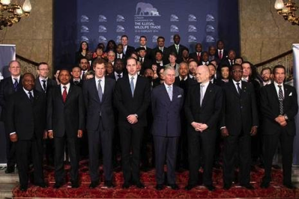
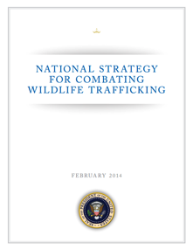
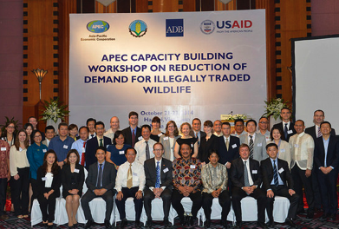
GLOBAL MOMENTUM
ASEAN Wildlife Enforcement Network
Indonesia-US Action to Protect Wildlife and Combat Wildlife Crime

Slide 43
Opportunities
Political – Indonesia has an opportunity for regional leadership
Much can happen without legal reform, and rapidly
Regional relationships can be strengthened – investigations stop at borders.

Slide 44
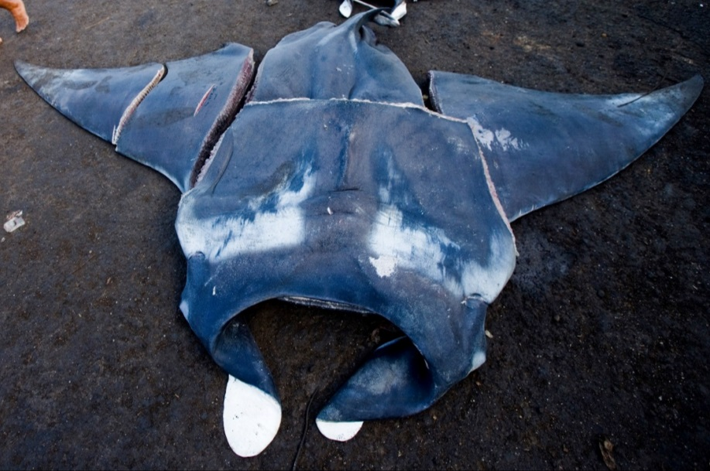
Solutions are possible: manta rays
Before 2012:
Indonesia is the world’s largest shark fishery (>120,000 tons/year)
During 2012:
Estimated 1,320 manta rays killed in Indonesia
March 2013:
CITES lists Mantas and 5 shark species on Appendix II for the first time
before 2012 2012 2013
During 2013:
Significant advocacy effort to lobby for manta protection in Indonesia (CI, WildAid, Shark Savers, WCS, WWF)

Slide 45
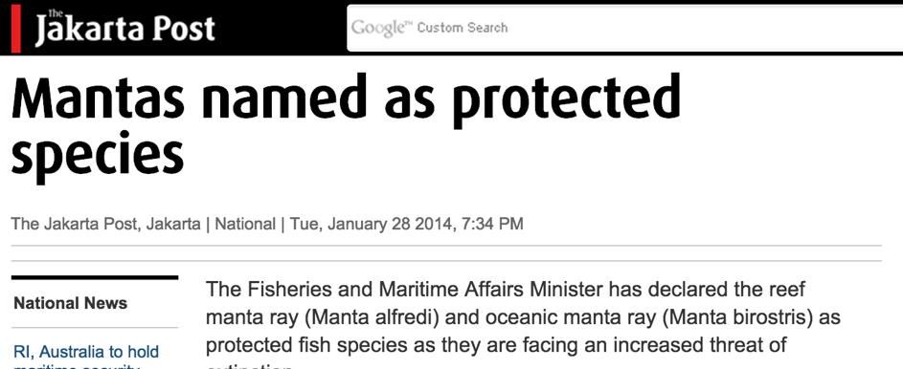
January 2014:
Indonesia declares mantas a protected species
22 August 2014:
First ever arrest of a manta ray trader, by MMAF, facilitated by WCS-WCU.
27 January 2015:
First manta trader jailed for 16 months and fined $5,000
April 2015:
8 arrests, all facilitated by WCS-WCU; 6 prosecutions finished; sentences up to 1.5 years
2014 2015
Main manta ray traders no longer selling manta products

Slide 46
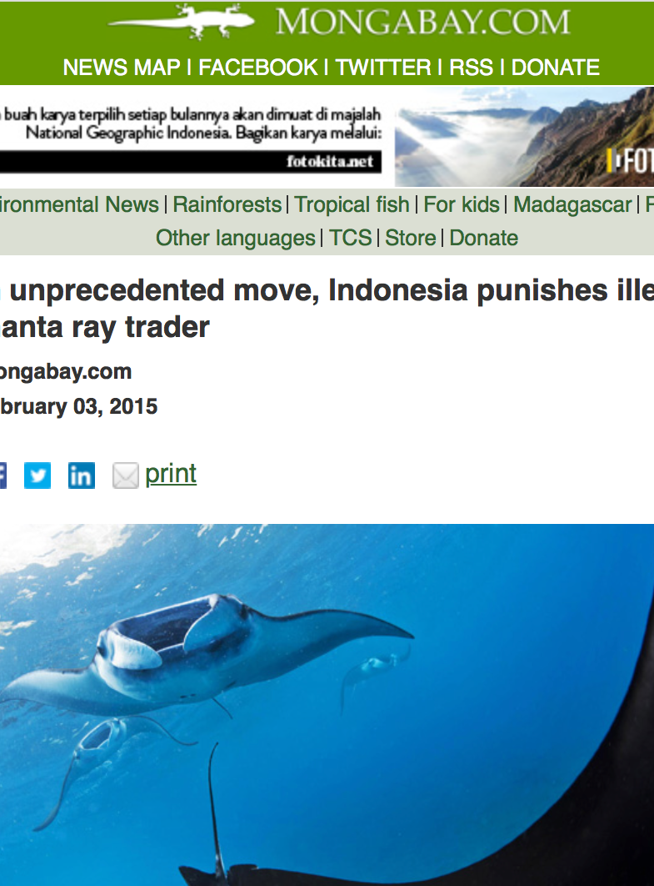
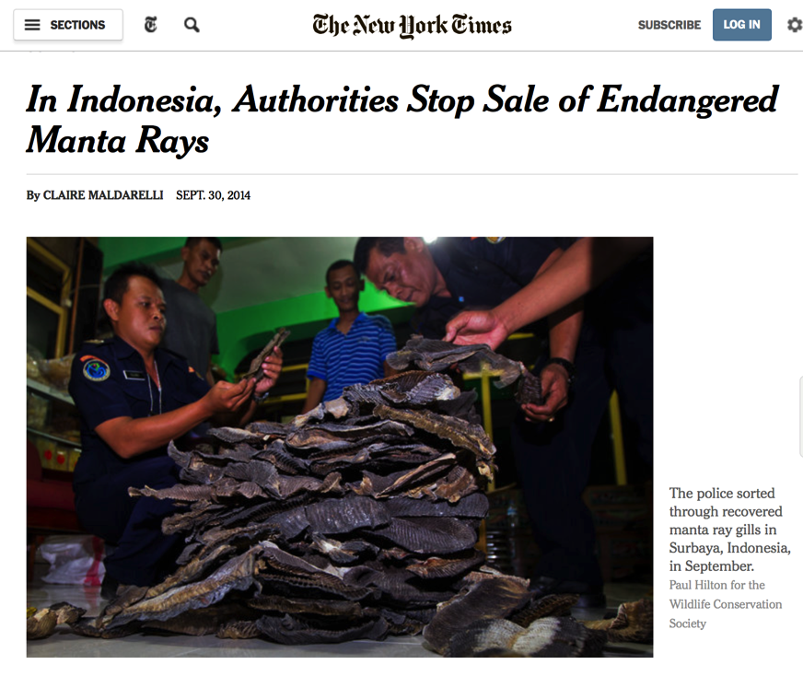

Slide 47
Thank you
Matt Leggett
mleggett@wcs.org

Slide 48
