Slide 1
Intelligence -led regional investigations
Indo-Burma Trafficking Network
Paksan Lao PDR -28th March 2016
Notes:
Introduction My back ground Reason here Presentation introduction to ILI Practical exercise Goals
Exercise is to promote a discussion and problem solving workshop on how we can investigate transnational crime, arrest/prosecute offenders and share information

Slide 2
Intelligence led investigations
Intelligence
Led
Policing
Traditional
Or
reactive
Policing
Notes:
Ratcliff simple analogy- reactive policing, crime scene and investigation. ILP going up stream to prevent the crime.

Slide 3
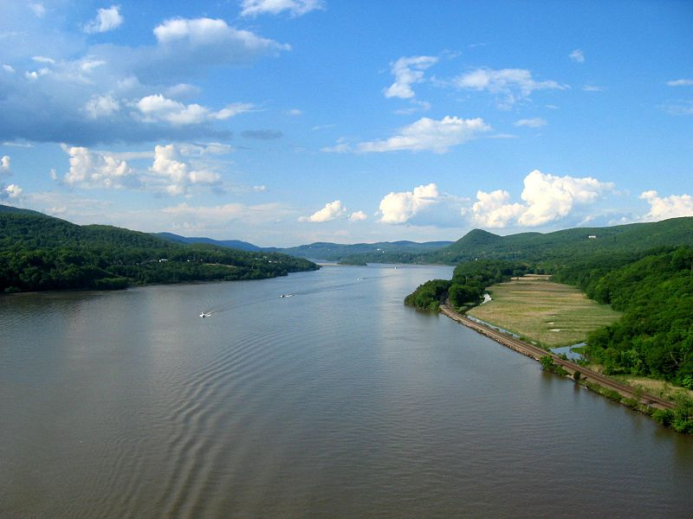
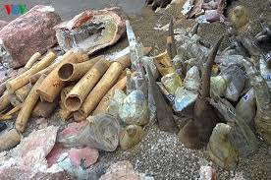
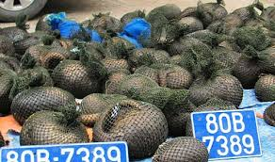
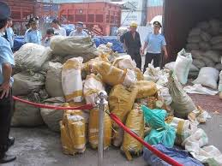
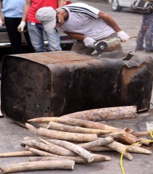
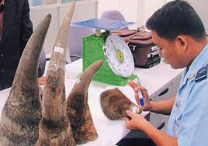
Are we doing all we can as investigators?
Has any
High level
Trafficker
Ever been
Prosecuted
?
Are we
Just
Pulling
The bodies
Out of
The river?
Notes:
Pulling the bodies from the river without any investigation. Very few top level traffickers are ever prosecuted.

Slide 4
Intelligence and intelligence led enforcement
Reactive policing (traditional policing) is reacting to a criminal incident
ILP is crime fighting guided by effective intelligence gathering and analysis
Notes:
The intelligence leads the police not the police leading the intelligence

Slide 5
Intelligence led law enforcement:
-Targets serious and prolific offenders
-Creates better resource allocation
-Predicts emerging area of criminality
-Dismantles networks by targeted investigations and prosecuting offenders.
-Results in better information sharing
Notes:
History (20 years) particularly effective against transnational and organised crime Police depts world wide

Slide 6
Information and intelligence
Information is not intelligence.
You do not collect intelligence….you collect information and produce intelligence.
Information plus analysis = Intelligence
Computers assist by compiling data into an easy assessable format to be analysed by a professional to form intelligence.
Notes:
ILP is Crime fighting guided by effective intelligence gathering and analysis

Slide 7
The intelligence cycle
Notes:
Direct resources

Slide 8
Seizures
Cannot be used as a measure of success
Only a single action in the enforcement chain
Rarely result in the arrest of high level traffickers.
Seizures do not appear to cause financial impact on illegal trade – shipments keep coming
Seizures may drive poaching since the commodity does not reach the market
An opportunity for a reactive investigation.....follow the trail. A good starting point for information that can be turned into intelligence.
Conduct a reactive investigation and follow the trail. An opportunity to gather information.
Notes:
Many seizures good enforcement or increasing crime? Few seizures poor enforcement of no trafficking

Slide 9
Sources of Information
Own investigations (overt/covert)
LE agencies
Wildlife traders
Wildlife restaurants
Wildlife farms
Journalists
Surveys
News scans
Internet forums
Informants
Government records

Slide 10
Information management
Where are we
Storing our
information?

Slide 11
Database management systems
Remember….Information in before Information out!
Notes:
Central database--- entire team can access can choose to share with other agencies

Slide 12
Simple Link Analysis
Notes:
Helps create an understanding of a network

Slide 13
Link Analysis
Notes:
A complex investigation

Slide 14
Managing and sharing information across international borders
-Interpol I 247
-World customs Organisation , CEN
ASEAN WEN
Contacts
Border Liaison Offices
Embassies
How are you
Doing it now?
Notes:
Luke Bond

Slide 15
Summary
If we are to effectively combat transnational wildlife crime we need to:
-Use intelligence led investigations and enforcement
-Share information and co operate with other agencies nationally and internationally
-Work together
We cannot succeed alone!

Slide 16
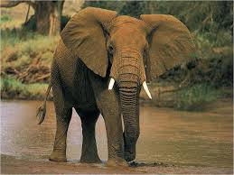
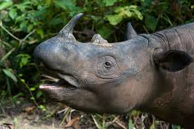
Thank you ຂອບ​ໃຈ cảm ơn bạn 谢谢

