Slide 1
VIETNAM PROGRAM
Oct 2013

Slide 2
WCS VIETNAM
Wildlife trade: Scott Roberton
Health: Amanda Fine

Slide 3
VIETNAM OVERVIEW
Both consuming and transitting country
Legally exports a large number of CITES-species to China each year including live primates, bears, turtles, monitor lizards, seahorses, and clams in addition to crocodiles (live, skins, meat and leather products), snakes (live, skins, meat and leather products), raw corals, plants (for Traditional Medicine and decoration), and carvings and pieces of timber. Sourced from Lao, Cambodia, Myanmar
Illegaly: all kinds of species, coming from SE Asia also Africa

Slide 4
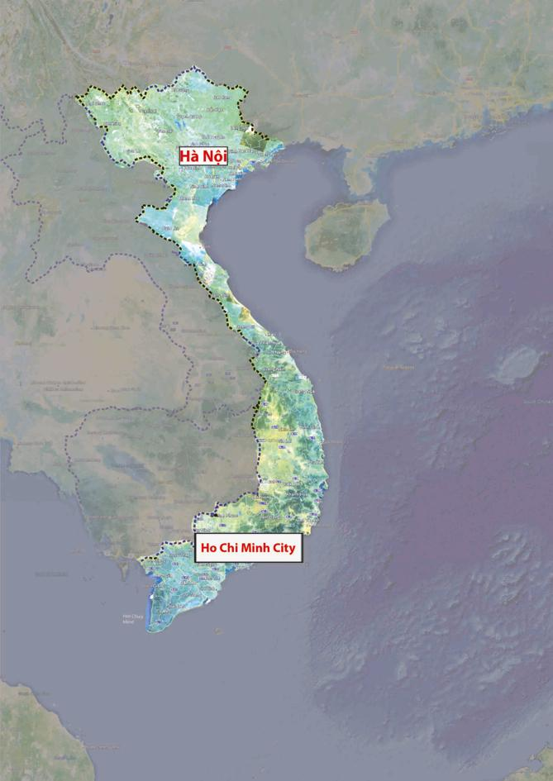

Slide 5
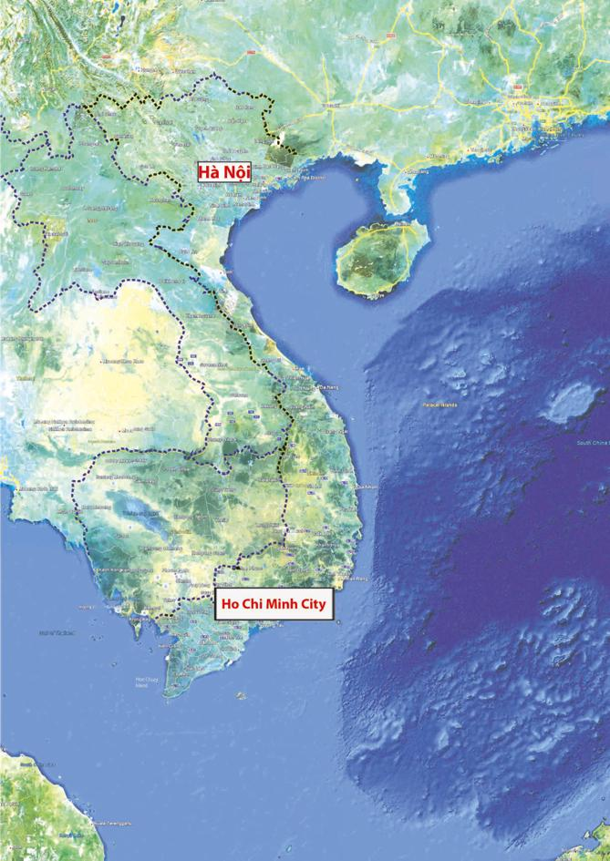

Slide 6
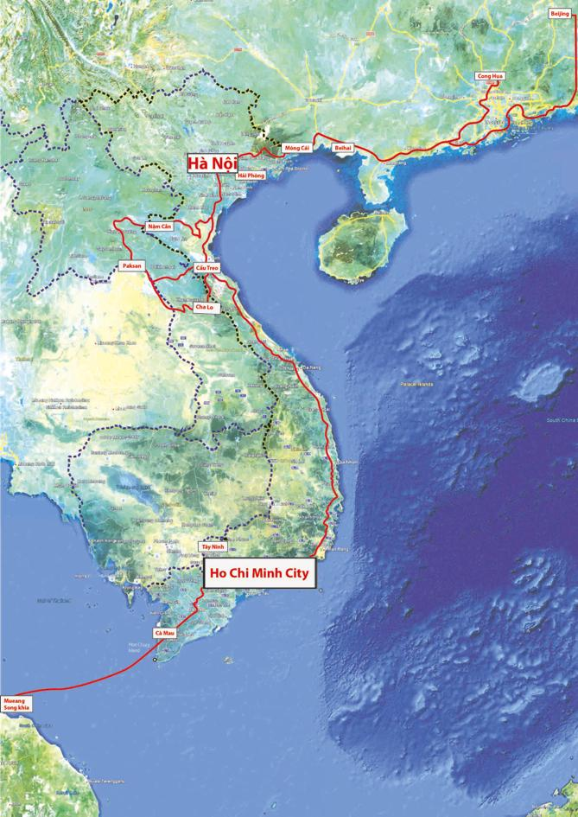
North
Central
South

Slide 7
OUR PROJECTS
Work along the trade route
Support global WCS strategy and other WCS programs in the region
Promote the fight against illegal wildlife trade through the health program and promote health risks through the trade program

Slide 8
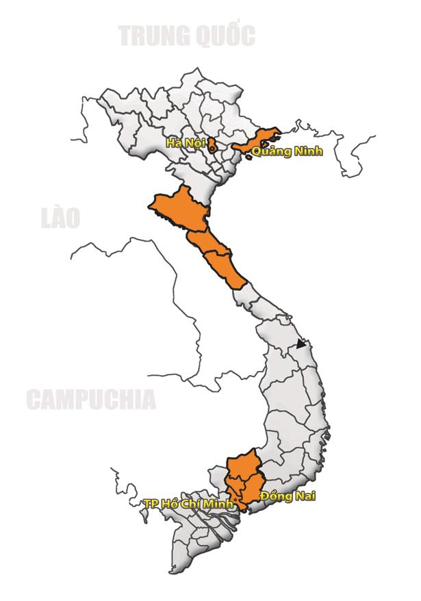
National
North
Central
South

Slide 9
NATIONAL LEVEL
Rhino, ivory and general support to the CITES MA
Samples and testing, working closely with Department of Health, Universities, Labs and other NGOs

Slide 10
PROJECTS IN THE NORTH
Short clip about WCS Vietnam work on the Vietnam - China border

Slide 11
PROJECT IN THE CENTRAL
Surveys of wildlife trade in Nghe An, Ha Tinh, Quang Binh (Eg. 82% restaurants selling wildlife trade in Quang Binh)
Collecting data of trade going through border gates
Review law enforcement activities
Trainings to law enforcement agencies (over 100 trained)
Building political will in provincial governments

Slide 12
PROJECT IN THE SOUTH
Surveys of retailers and private zoos in Ho Chi Minh metropolitan area
Trainings to law enforcement agencies
Building political will in provincial governments
Supporting activities to law enforcement in Binh Phuoc province adjacent to Seima

Slide 13
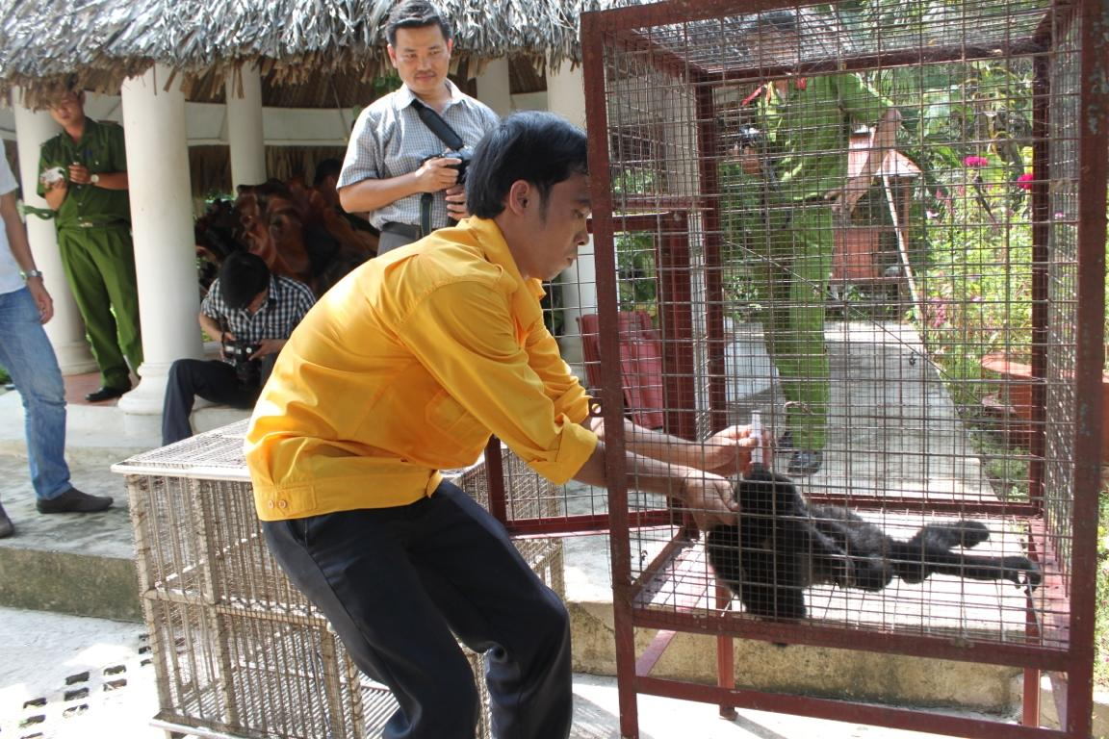
Crack down in Binh Duong 7/2013

Slide 14
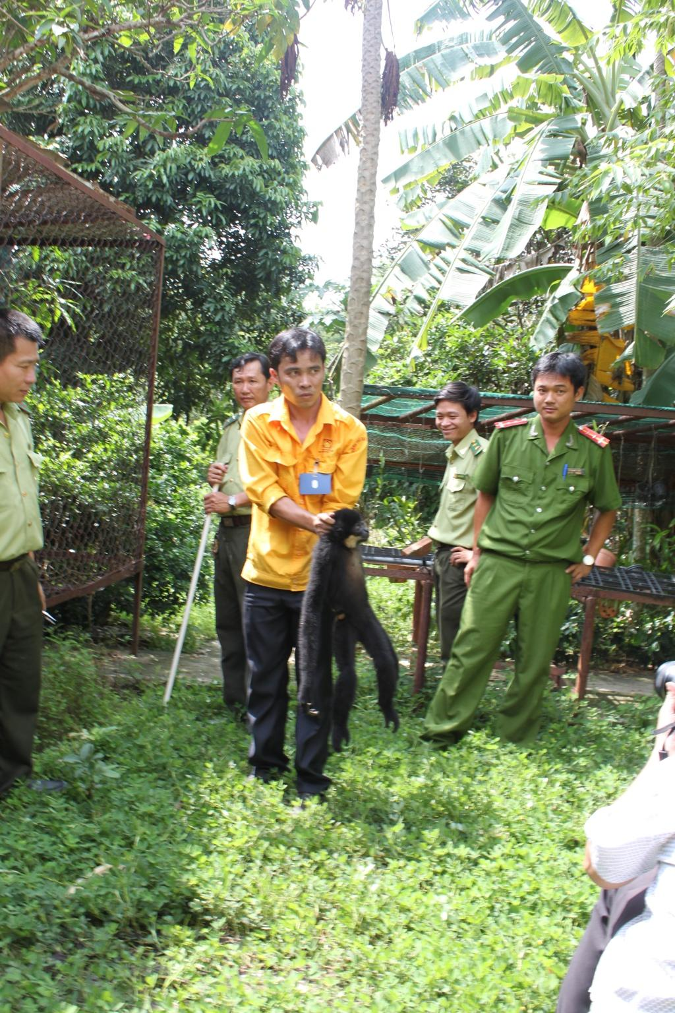

Slide 15
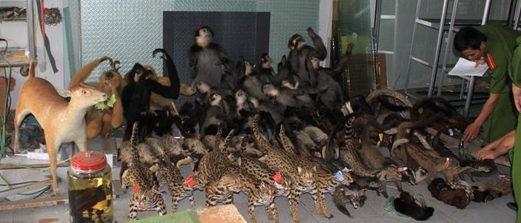
Crack down in Dak Nong 9/2013

Slide 16
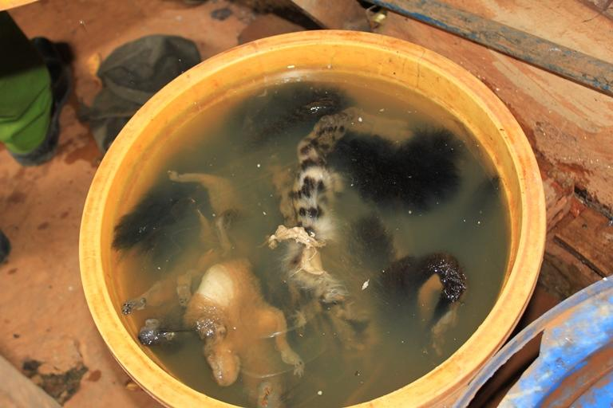

Slide 17
Q & A

