Slide 1
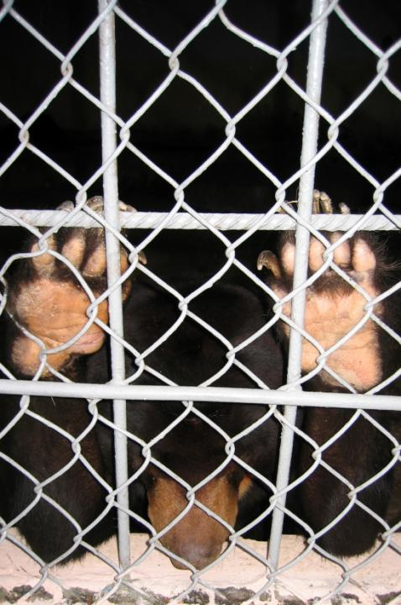
WCS China
Trade Program
2013

Slide 2
Innovation
Public Awareness
Capacity Development
WCS China Trade Program
Policy Analysis
Technical Support
Market Monitoring

Slide 3
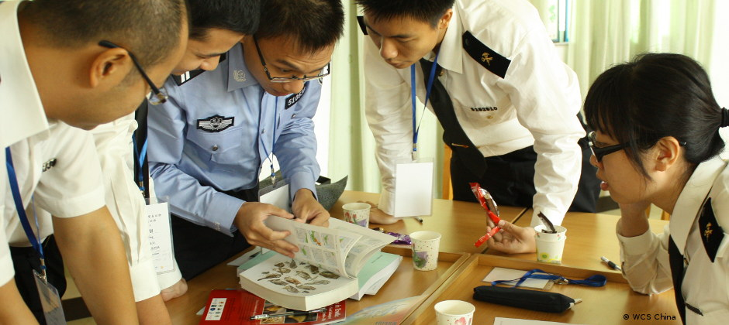
Capacity Development
Law enforcement agencies Local NGOs
Needs assessments
Training materials and handbooks

Slide 4
In house WCS expertise
Network of authoritative partner experts
Guaranteed <8h response time
Jan-Mar 2013, 4 incoming inquiries, 100% followed up within 20 min
Technical Support

Slide 5
Species identification mobile phone software:
Tailored to law enforcement agencies, NGOs and wildlife advocates
Featuring intuitive search functions for identifying wildlife species and products
Featuring immediate reporting of the findings to law enf. or wildlife protection organizations
Innovation

Slide 6
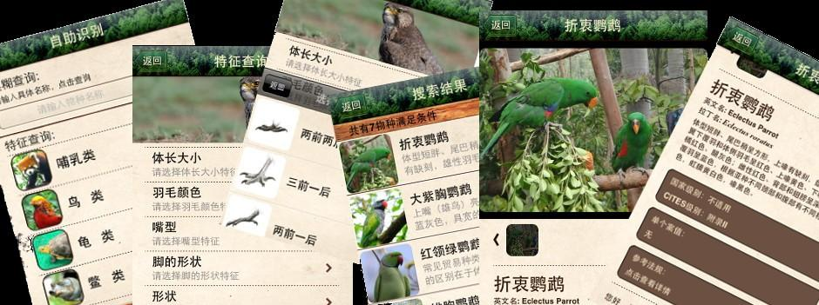
Official endorsement by CITES MA China
iOS and Android [Dec. 2013]
400+ species database
Authorized experts support
700+ downloads in the first 3 months from the release of the preview version

Slide 7
广州
黄沙水产 Huang Sha (food)
花地湾 Hua DiWan (pet)
天嘉批发 Tian Jia (food)
清平沿路散店 Qing Ping road (TCM)
online
Market Monitoring

Slide 8
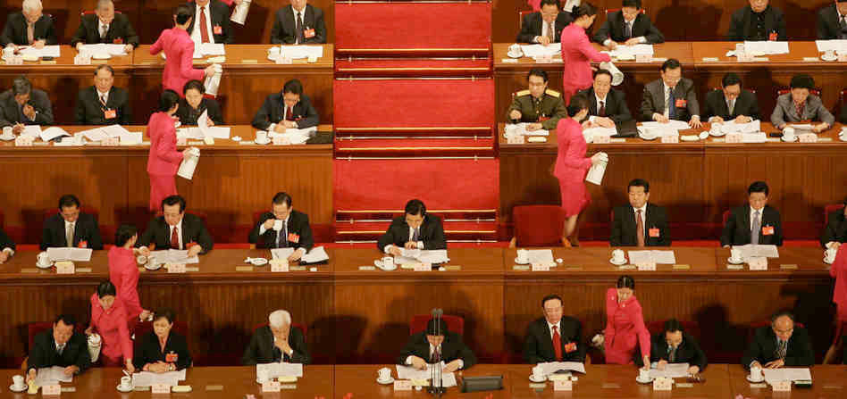
Policy Analysis
Comprehensive review of current Chinese laws and regulations for wildlife protection at the national and provincial level.

Slide 9
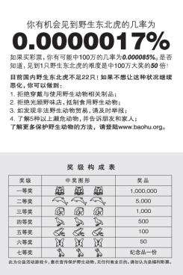
Public Awareness
Citizen sensitization initiatives about the rarity of endangered species
Media campaigns to revert the luxury connotations of owning wildlife

Slide 10
Social Media
Campaign
Use Social Media’s spread influence to integrate the new-generation communication strategy for wildlife conservation
Create cross-industry cooperation on the campaign and have more enterprise and individual involve in the conservation movement

Slide 11
WCS China Trade Program
Innovation
Public Awareness
Capacity Development
WCS China Trade Program
Policy Analysis
Technical Support
Market Monitoring

Slide 12
Thank you!
Ramacandra Wong rwong@wcs.org

