Slide 1
Breaking the Chain:
Building a Civil Society-Government Transnational Partnership
to Combat Major Wildlife Trade Networks in Lao PDR, Vietnam and China
Scott Roberton PhD
Wildlife Conservation Society
March 2015

Slide 2
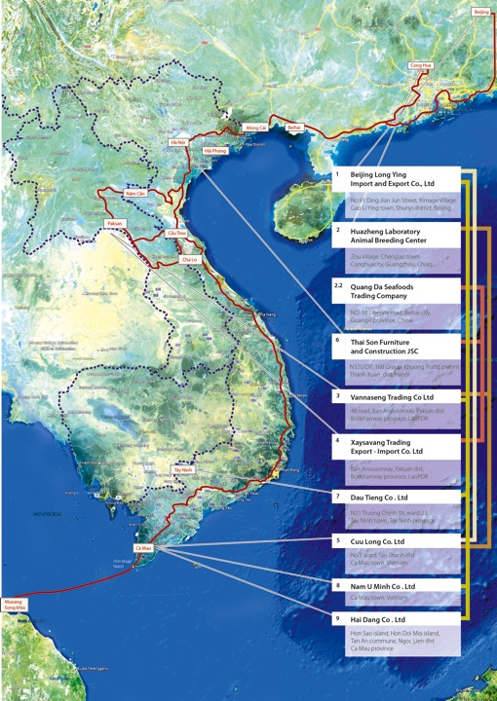
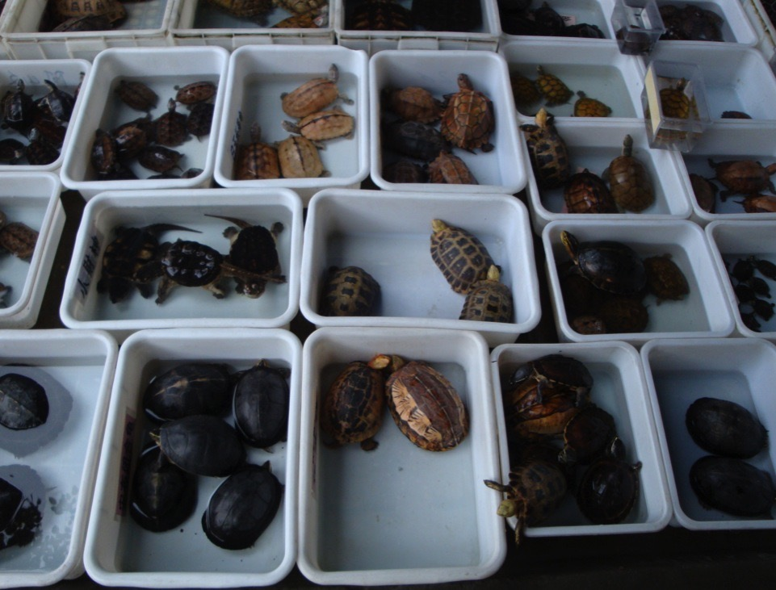
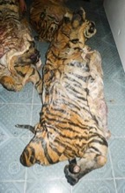
Massive trade in Reptiles across Asia
Average of two shipments/month of 1200-5700 individuals/shipment
Wild-sourced from Lao, Cambodia, Myanmar, Malaysia, Thailand
2 Lao companies, 5 Vietnamese companies and 2 Chinese companies
Notes:
WCS has been working with authorities on a multi-national trafficking network operating across IndoBurma (Myanmar across to China)
With funding from CEPF in 2009-2012 our intelligence-gathering uncovered a massive trade in wild-caught reptiles across SEA to supply Chinese markets
Since then, we have confirmed these networks are also involved in the trade of other products such as lion & tiger bones, ivory, pangolins, macaques and rhino horn
2006-2010 data on trade found regular shipments of around two containers/month of upto 6000 indvs of HS Turtles, Monitor lizards, and snakes
We are continuing investigations right now, but recently we received intelligence from the first 11mths of 2014 of 2 Lao companies moving 300 tonnes of these taxa, of which 133t was turtles, which could translate to more than 50,000 turtles
Two companies in Lao PDR – VN-CN
Live turtle 133,000kg
Live snake 95,000kg
Live water monitor 71,000kg
Results of data collection of wildlife and aquatic trade in 2014 are:
Vannaseng Company:
Live turtle 128,345 kg
Live snake 92,646 kg
Live water monitor + monitor Lizard 69,516 kg
Live soft shell turtle 2,607 kg
Lion + Tiger bone 2,891 kg
Elephant part 22,355 kg

Slide 3
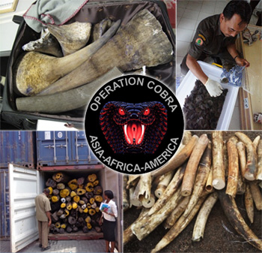
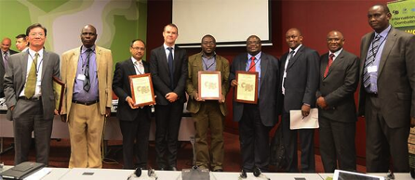
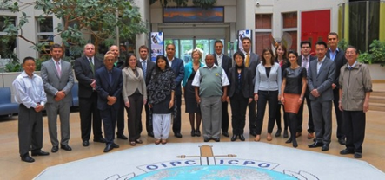
International law enforcement cooperation against wildlife trafficking networks is in its toddler years
Notes:
International cooperation on law enforcement against wildlife trafficking networks has improved in recent years, but there is much improvement to be made
Welcome the Operation COBRAs and other Interpol operations
Activity increased of International mechanisms (e.g. Interpol, UNODC, CITES), regional support initiatives (e.g. ASEAN-WEN) and enforcement operations (e.g. Operation Cobra) all provide greater opportunities for coordination between countries but are only as strong as their participating member countries.
Many government agencies responsible for combating the illegal trade across the region still lack the political and legislative frameworks, resources, higher-level political commitment, or skills to mount an effective response.
We felt there was a disparity currently between the efforts invested in establishing global and regional mechanisms and the effort required at national levels to support their participation in such mechanisms.
Most of these regional initiatives have failed to incorporate objective metrics that would enable a clearer understanding of their achievements and weaknesses.
Scorecards on arrests & seizures tell us very little to the impact on trafficking networks or the level of the criminal network affected and the final punishment.
Improving indicators for effective enforcement would bring accountability to existing reporting of govt as an adaptive mgt tool but would also add pressure – already working on this in VN
What was happening beforehand/after compared to the period of the operation to see what added value it gave and secondly, scorecards on arrests & seizures tell us very little to the impact on trafficking networks, the level of the criminal network affected and the final punishment.

Slide 4
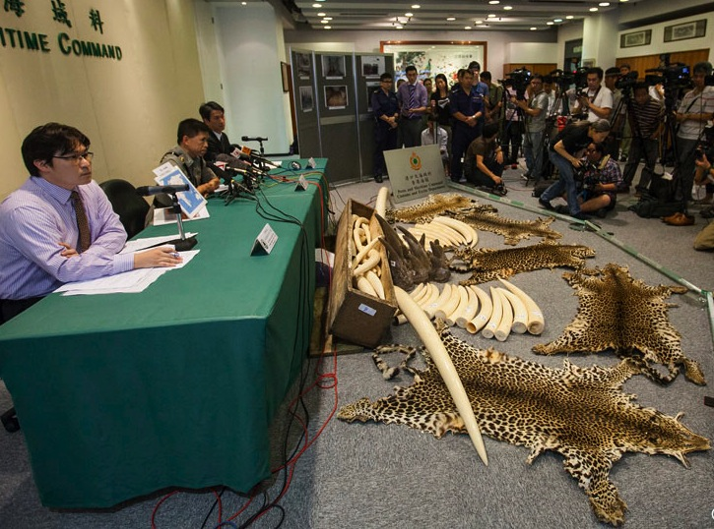
Seizures of products from dead animals celebrated as a success….
Notes:
Indeed - seizures I believe are far too much the focus of the public face of enforcement in this field.
For example we must stop politics getting in the way of enforcement.
The current trend of celebrating seizures as quick as possible needs to be changed
A seizure alone has a limited deterrent effect if not accompanied by the arrest, prosecution and punishment of the individuals behind the shipment

Slide 5
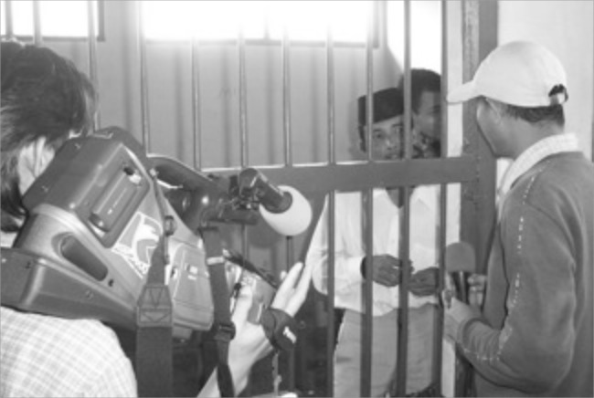
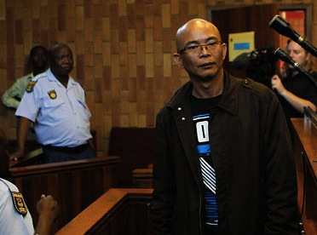
Success is when the criminals who are behind the illegal slaughter and trade of these animals are brought to justice
Notes:
The celebrations and press conferences should really be held when the criminal networks bringing the horns out of Africa and into Asian markets are dismantled
This is happening, but I believe if we started to utilize more reliable measures on wildlife crime and enforcement effectiveness it would further drive more effective enforcement and targetting of suspect…
WCS- WCU – Indonesian Tiger trader here in jail

Slide 6
Criminal justice system not effectively addressing the criminal groups in Asia yet
2008-2013
19 rhino horn arrests
1 person jailed
Some small fines
Many cases still open
No additional arrests following interrogation
Notes:
For example, in Vn, WCS has been working with the authorities to promote exactly that, something we are expanding across our programs in Asia.
where the limited people actually being arrested are rarely facing a fine or jail term
There needs to be transparency and objective reporting of this sort of data to allow IOs and govts to analyse enforcement effectiveness
Moving past reporting seizures and arrests in reports to measures that inform on enf effectiveness and guide strategies and resource allocations

Slide 7
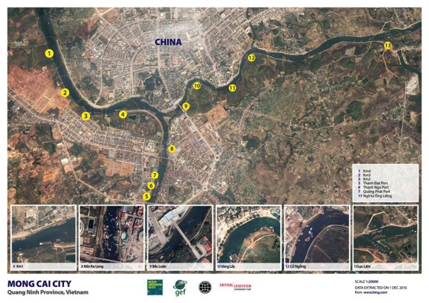
Notes:
With CEPF funding from 2009-2012 WCS generated a series of intelligence products, communicated these to multiple levels of the government
This led to some promising results
In part these efforts resulted in revised policies on cross-border regulation, the establishment of a PM’s task force addressing smuggling in Mong Cai, a series of changes to how officers are deployed on the border and the arrest, prosecution, and asset seizure of 18 members of the major smuggling syndicate and an Interpol red notice posted on

Slide 8
Key components of previous work taken to scale for this project
Builds upon WCS’s active presence in these countries and close government relationships.
Notes:
So we took the key components of our previous work that focused on the VN-CN border to the development of this current project where we hope hope to take that success to greater scale along the wider Indo-burma trade chain from Bolikhamxay province through Central VN
Accurate and compelling information
Actionable intelligence
Communication to multiple points in government in a non-threatening manner
Close, supportive relationship with key agencies
This builds upon WCS’s active presence in these countries and close government relationships…
We are also initiating similar approaches with Indonesia and also with ivory/rhino horn trafficking from Africa

Slide 9
?
?
?
?
?
Accurate information and intelligence will be generated and disseminated on the criminal individuals, companies, species traded, and modus operandi along a major international trade route
Notes:
The first step, which is where we are now is to gather and analyze information on the trade network.
Whilst the wildlife traders have been cooperatively internationally for some time, its somewhat new to us as an NGO to implement a project f this type where all activities. This is the first sub-regional project for WCS of this kind so in all three country programs we are all getting used to working much closer together and more coordinated.
Accurate information and intelligence will be generated and disseminated on the criminal individuals, companies, species traded, and modus operandi along a major international trade route

Slide 10
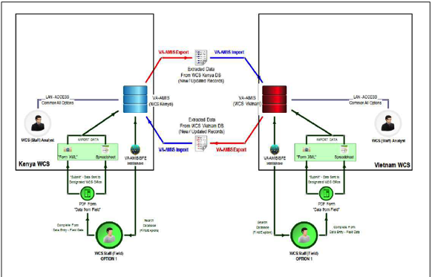
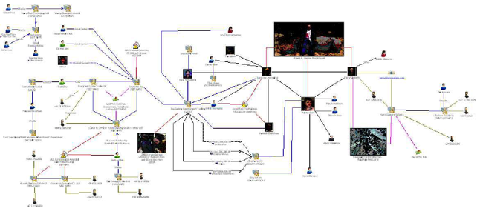
Notes:
We are also currently in the process of deploying a professional intelligence management/analytical tool to out country offices that will support better info/intell manamengt and better production of intell products for govts but also enable us to promote intelligence led approaches to the Govt

Slide 11
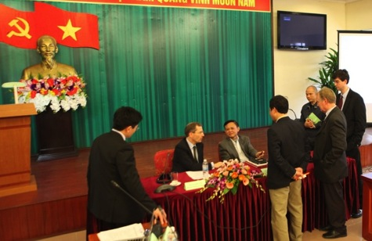
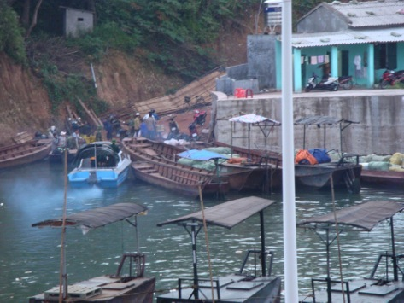
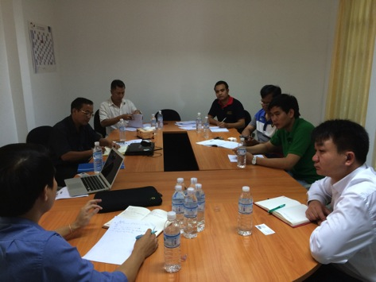
Increased political support towards effective enforcement on wildlife criminals
Notes:
The next major component is about activating effective enforcement action and bringing the people behind these networks to justice.
Understanding how to do that requires local knowledge to the development of specific influencing strategies – one size does not fit all in this case.
This will involve more standard tools such as investigative journalism pieces, and facilitating pressure from the diplomatic sector, IOs and bi-lateral partners such as WB/ADB
It will be private, small briefings to key parts of government on our intel findings such as National Assembly, National Forest Police etc
But critically in this project we are looking at leveraging geo-political pressure between the three countries to activate action.
China’s influence in both countries and desire to be a regional leader
Vn’s influence on LA and its own desire to outshine CN
Its likely that much of this work wont be WCS branded… if we were too public about it, it would undermine this approach

Slide 12
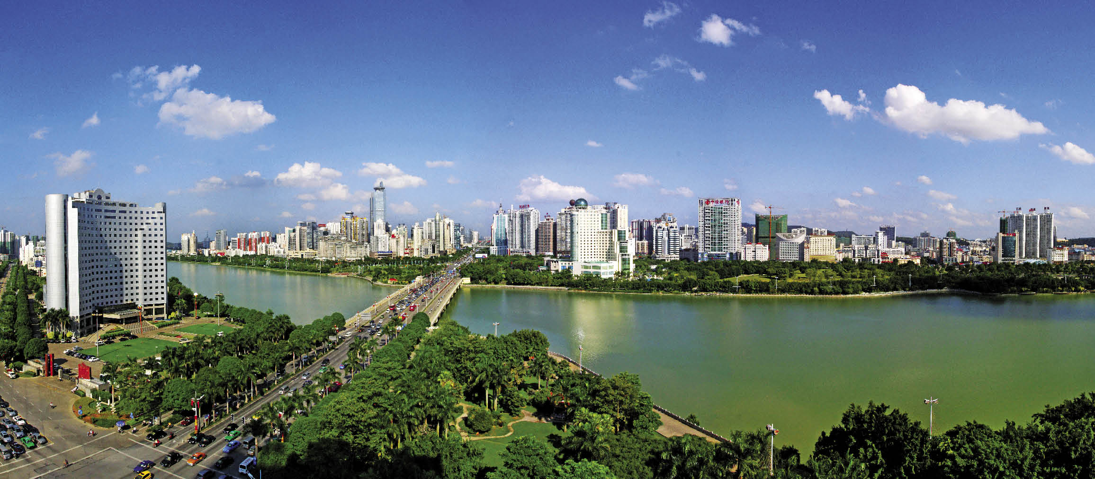

Slide 13
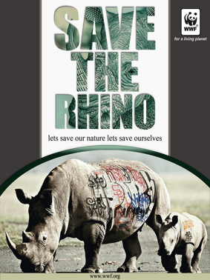
Greater work needed on Consumption
Heavy focus on awareness-raising
Inaccurate methods to monitor consumption
Notes:
Alone though this is insufficient – we believe greater work is needed around BC on consumers
Current demand reduction campaigns are heavily focused on awareness-raising, and often the voice coming across is from an international organization
Consumer awareness campaigns are important for some stakeholders, but probably have limited impact in isolation on reducing demand…
Too much funding currently invested in Awareness Campaigns.
In Viet Nam and China whilst consumer awareness-raising initiatives are a critical component to demand reduction, alone they do not provide a comprehensive solution.
As we all know, being aware of an issue does not necessarily lead to an attitudinal and/or behavioural change resulting in reduced consumption.
Repeated, standardized surveys of consumers and an assessment of policies, poaching rates, and enforcement measures
Robust monitoring is urgently required to measure the effectiveness of demand reduction efforts

Slide 14
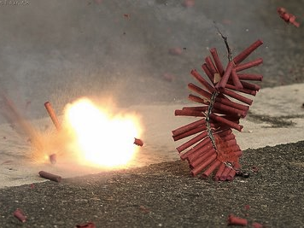
Governments action, or inaction are important drivers to changing traditional consumptive behavior
Notes:
Demand reduction requires a multi-pronged approach
The governments of Vietnam and China have made widespread behavioral changes in traditional consumptive practice through policy and law enforcement.
The 1995 ban on firecrackers in VN, a lunar new year tradition going back over a thousand years, was stopped overnight with enforcement and almost no awareness campaigns – the ban remain effective to date.
Indeed one thing that all the various consumer research agree upon is that those who intend to buy ivory believe a govt ban would discourage them
In these countries, government action, and too often Government inaction, is a critically important driver of illegal consumer behaviour. - e.g. The Government of Vietnam has made past widespread changes to traditional consumptive behaviours of its citizens primarily through policy and effective law enforcement. For example, with almost no awareness campaigns, in 1995 Vietnam enacted a ban on firecrackers that had been used for traditional lunar new year celebrations for hundreds of years: the ban remains in force and effective to date. Investment is lacking on Crime-prevention campaigns. These would focus on creating, implementing, and promoting strengthened policies, and law enforcement actions to increase the perceived risk for people to partake in wildlife crime. WCS is working with media and government in VN and CN on such campaigns.

Slide 15
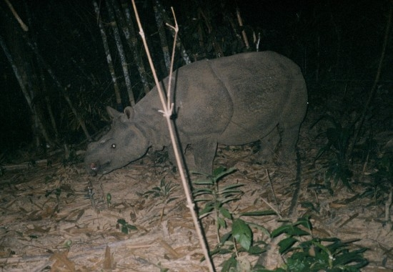
Scott Roberton PhD
Wildlife Conservation Society
sroberton@wcs.org / @owstons
Notes:
To prevent the extinction of more species in Indoburma….

